Slide 1
Universitäres Institut akkreditiert nach HFKG
Institut universitaire accrédité selon la LEHE
Diagnosing 3S
Notes:
Recent paper
Not discuss everything. Mostly important for the question raised and idea of future directions and projects.

Slide 2
Methods

Slide 3
Line intersections
2
5
Rationale: Synesthetic forms should have less line intersections. This is due to a coherent form.
4
1
3
i.e. 3 crossings:
1-2 & 3-4
1-2 & 4-5
2-3 & 4-5

Slide 4
Line intersection method
Description: for each conditions:
Months (12 stimulus): 11 segments
Weekdays (7 stimulus): 6 segments
Numbers (10 stimuli): 9 segments
X 3 Repetitions
Speratedly by ID X Condition X repetition: compute sum of segment intersections
Divide by number of segments by conditions.
Compute average by ID. (Could do a sum, so if 0 in a conditions would not penalize the score).
=> Higher nubmer = more likely to have intersections between segments.

Slide 5
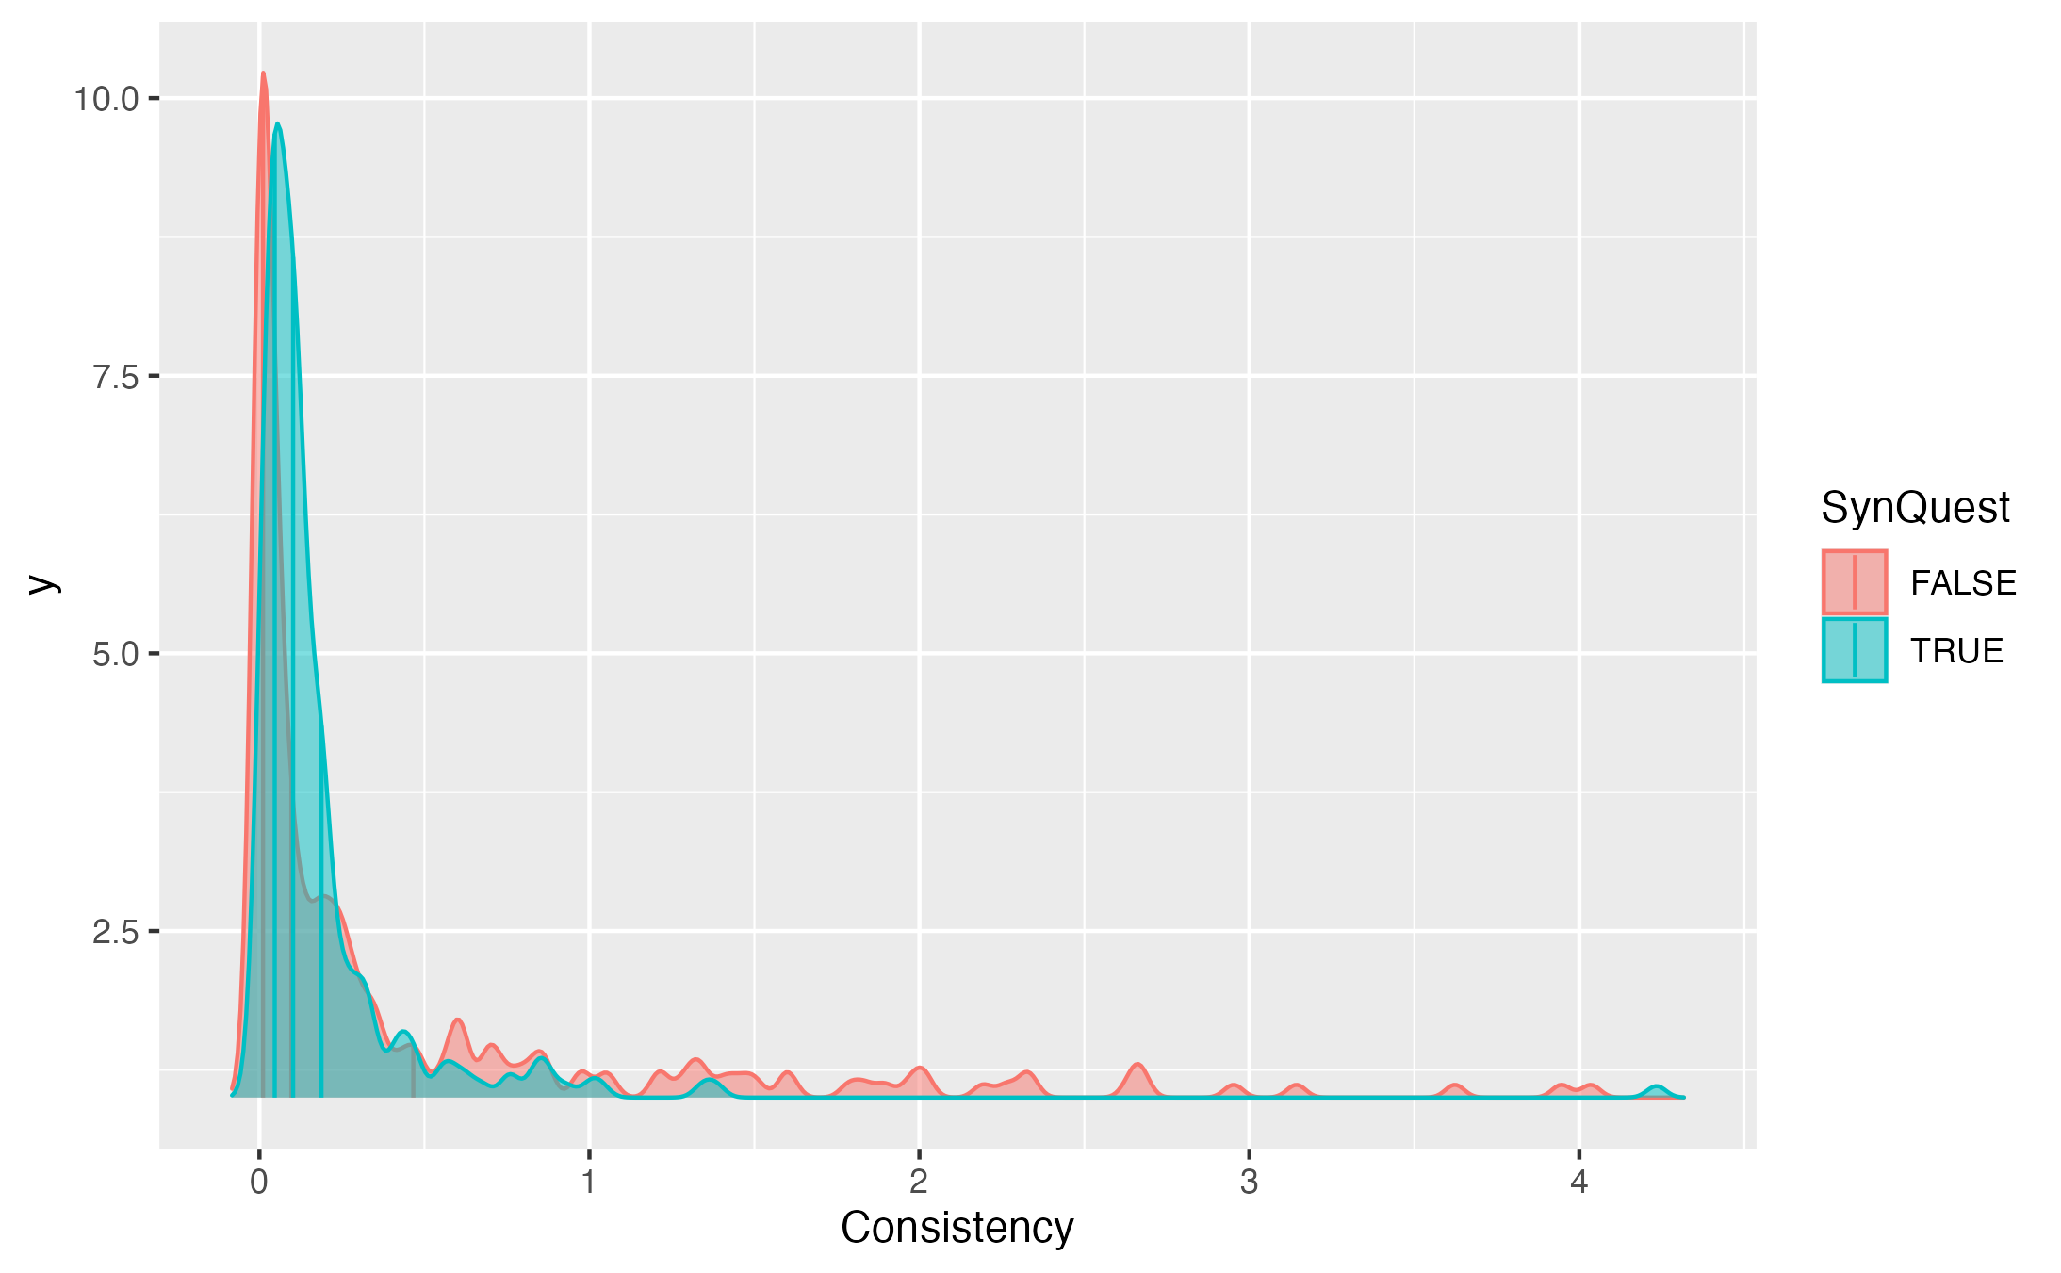
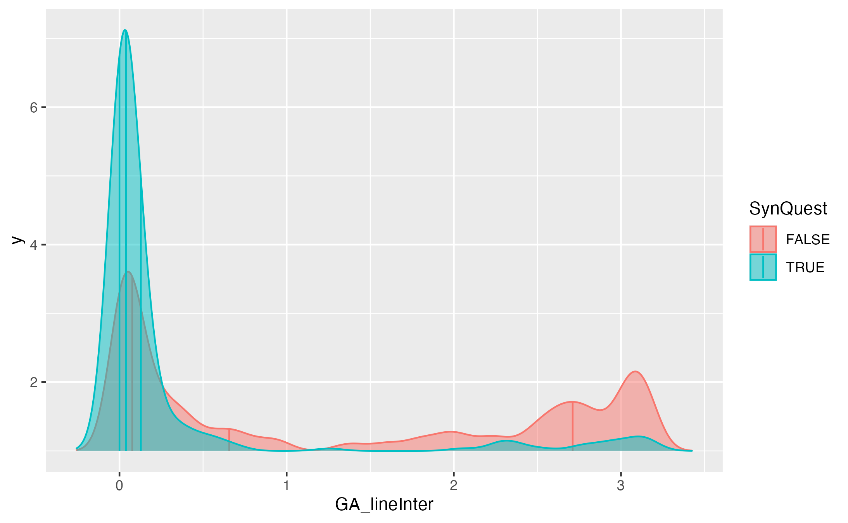
Consistency vs “Line intersection”
Median Syn
Median Syn
Median Ctl
Median Ctl
Notes:
Distributions should differ in median, not overlap.

Slide 6
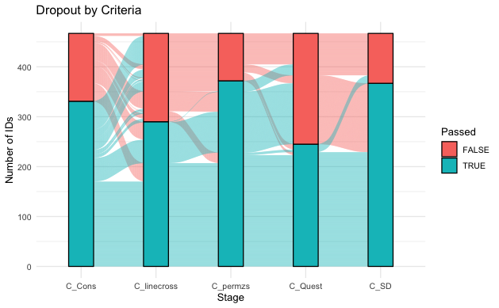
Comparing criteria
Only Ward Data

Slide 7
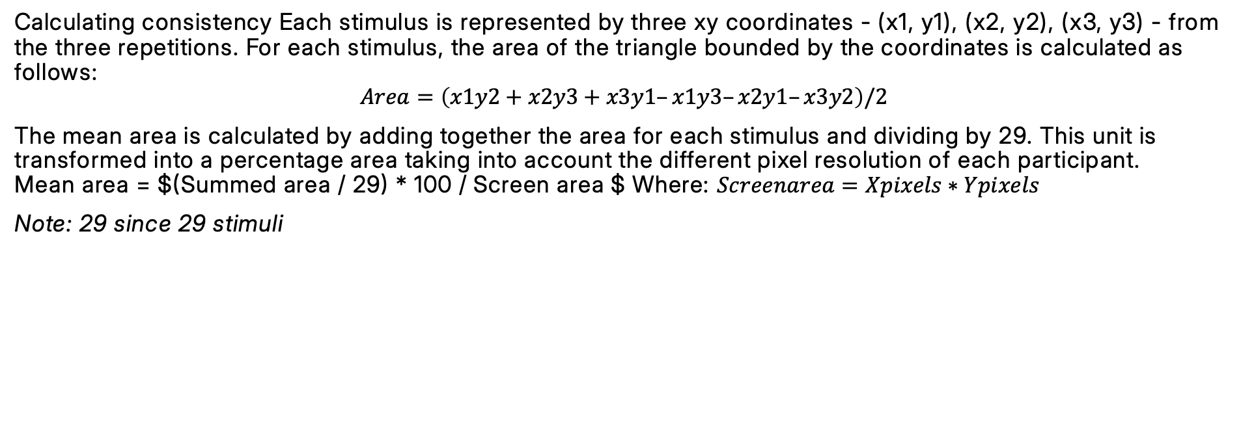
1. Compute Consistency:
Calculating consistency Each stimulus is represented by three xy coordinates - (x1, y1), (x2, y2), (x3, y3) - from the three repetitions. For each stimulus, the area of the triangle bounded by the coordinates is calculated as follows:
$$Area=\left(x1y2+x2y3+x3y1–x1y3–x2y1–x3y2\right)/2$$
The mean area is calculated by adding together the area for each stimulus and dividing by 29. This unit is transformed into a percentage area taking into account the different pixel resolution of each participant. Mean area = $(Summed area / 29) * 100 / Screen area $ Where: $Screenarea=Xpixels∗Ypixels$
Note: 29 since 29 stimuli

Slide 8
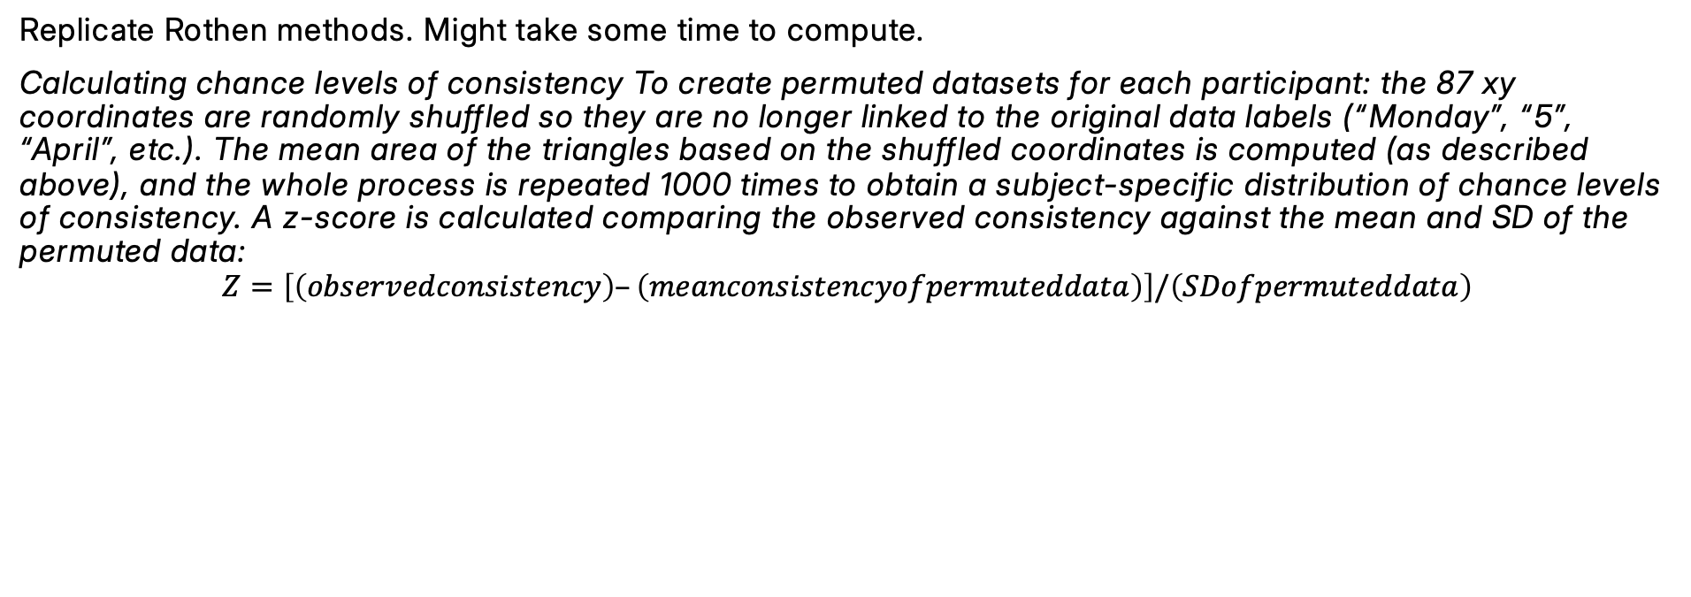
2. Compute Permuted consistency
Replicate Rothen methods. Might take some time to compute.
Calculating chance levels of consistency To create permuted datasets for each participant: the 87 xy coordinates are randomly shuffled so they are no longer linked to the original data labels (“Monday”, “5”, “April”, etc.). The mean area of the triangles based on the shuffled coordinates is computed (as described above), and the whole process is repeated 1000 times to obtain a subject-specific distribution of chance levels of consistency. A z-score is calculated comparing the observed consistency against the mean and SD of the permuted data:
$$Z=\left[\left(observedconsistency\right)–\left(meanconsistencyofpermuteddata\right)\right]/\left(SDofpermuteddata\right)$$

Slide 9
3. Compute SD as in Ward
As in Ward:
“Specifically, the standard deviation of the x-coordinates and/or the standard deviation of the y-coordinates (measured across all trials) should exceed a proposed value of 0.075 for a normalized screen with width and height of 1 unit.”
“A participant who produced a horizontal straight-line form would have a very low standard deviation in the y-coordinates but a high standard deviation in x-coordinates, and a participant with a vertical line would have the reverse profile. A participant with a circular spatial form would be high on both. A participant who clicks randomly around the screen would also be high on both x and y standard deviation, but would fail the consistency tests (the triangles would be large).”
[1] 0.2030271

Slide 10
5. Compute line intersections
4.2. Line intersections
Arbitrary threshold of 0.25.
GA_lineInter is the general average of all repetitions and conditions, of the chances that two segments within each Condition and repetition would cross. That is, for each IDXConditionXrepetition separatedly, we computed the number of segments that crosses in ordered stimuli (note the number of segment is the number of stimuli - 1), divided by the number of segments. This gives, for each IDXConditionXrepetition separately, the chances that two segments intersect. This chance is then averaged for each ID. This also means that conditions with more stimuli might have smaller averages (?). Could also compute the median.

Slide 11
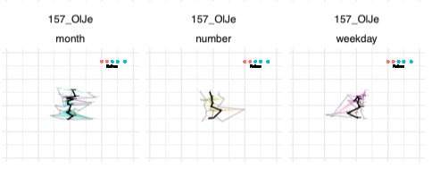
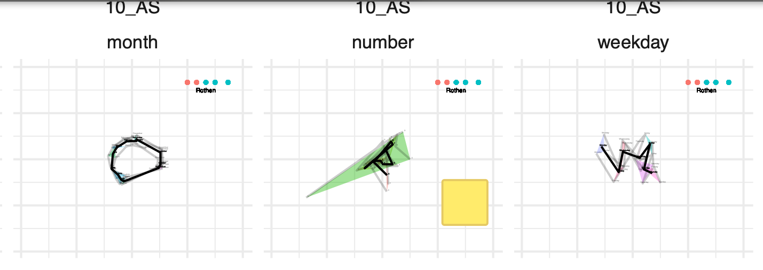
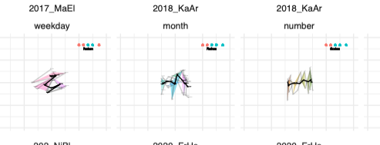
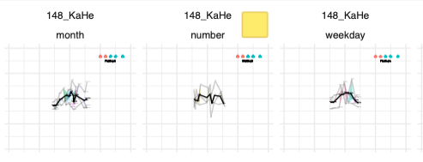
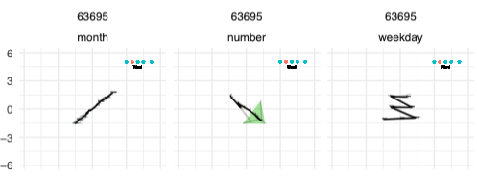
Examples I
Inconsistent but pass intersections

Slide 12
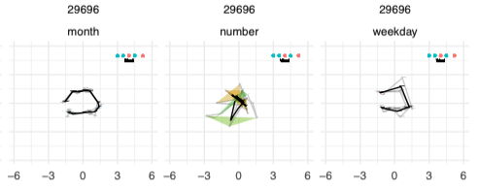
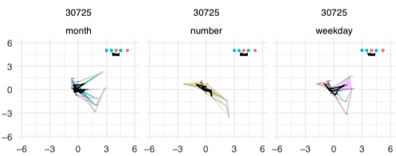
Examples II
Consistent do but not pass intersections

Slide 13
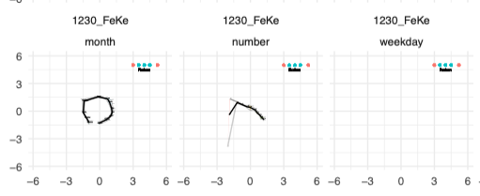
Examples III
No lines
Should the test be passed in all conditions ? (i.e. should sequence space synesthesia be diagnosed:
if months & weekdays & numbers
(conservative)
Or
if months | weekdays | numbers
(liberal)
Notes:
If liberal could sum instead of average the line intersections (so number = 0).

Slide 14
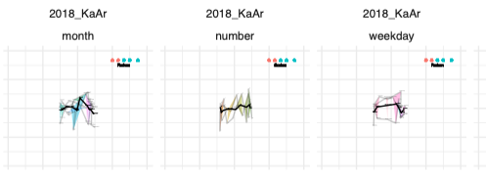
Example IV
Number line

Slide 16
Discussion with NR
Questionnaire
Q1 . Some people routinely think about sequences as arranged in a particular spatial configuration (as in the examples below), do you think this might apply to you? (1=strongly agree, 5= strongly disagree) | Q2_numbers (1=present, 0=absent) | Q2_days (1=present, 0=absent) | Q2_months (1=present, 0=absent) | Q2_years (1=present, 0=absent) | Q2_letters (1=present, 0=absent) | Q2_temperature (1=present, 0=absent) | Q2_height (1=present, 0=absent) | Q2_weight (1=present, 0=absent) | Q3 Where do you tend to routinely experience these sequences? (1= in the space outside my body; 2= on an imagined space that has no real location; 3= inside my body; 4= this doesn't apply to me!)
Q4_colours (1=present, 0=absent) | Q4_shading (1=present, 0=absent) | Q4_2D (1=present, 0=absent) | Q4_3D (1=present, 0=absent) | Q4_perspective (1=present, 0=absent) | Q4-blocks-or-tiles (1=present, 0=absent) | Q4_font (1=present, 0=absent)
Q5 Before doing this experiment, I always thought about NUMBERS as existing in a particular spatial sequence (1= strongly agree; 5= strongly disagree) | Q6 Before doing this experiment, I always thought about DAYS OF THE WEEK as existing in a particular spatial sequence (1= strongly agree; 5= strongly disagree) | Q7 Before doing this experiment, I always thought about MONTHS OF THE YEAR as existing in a particular spatial sequence (1= strongly agree; 5= strongly disagree) | Q8 I use this way of thinking about spatial sequences in my everyday life (1= strongly agree; 2= strongly disagree) | Q9 When doing the experiment, I didn't have any strong intuition as to where to put the NUMBERS (1= strongly agree; 5= strongly disagree) | Q10 When doing the experiment, I didn't have any strong intuition as to where to put the DAYS OF THE WEEK (1= strongly agree; 5= strongly disagree) | Q11 When doing the experiment, I didn't have any strong intuition as to where to put the MONTHS OF THE YEAR (1= strongly agree; 5= strongly disagree) | Q12 This experiment didn't really make much sense to me (1= strongly agree, 5= strongly disagree) | Q13 Feel free to enter any comments here. E.g. what strategy did you use? Do you want to clarify any of the above answers?

Slide 17
Question
How to compare criteria?
Add other data?
How to set cutoffs?
Average or sum conditions?
Random walk (possible issue with repetitions)?

Slide 18
Vielen Dank für Ihre Aufmerksamkeit! Merci pour votre attention ! Thank you for your attention!
Universitäres Institut akkreditiert nach HFKG
Institut universitaire accrédité selon la LEHE

Slide 19
Line Intersect

Slide 20
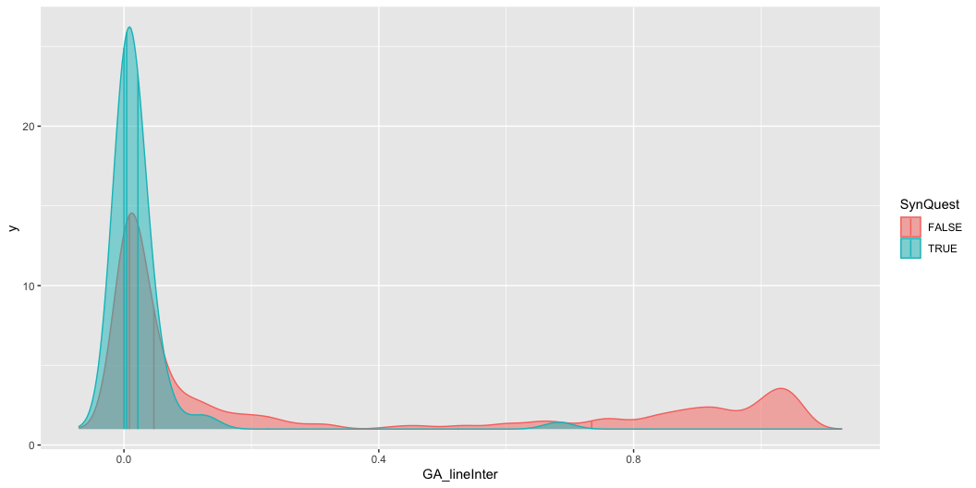

Slide 21

Questionnaire score: 9.00 n ID pass Quest: 142.000000 Accuracy: 0.42 Sensitivity: 0.21 Agreement: 0.42 |SynQuest | Med_Cons| SD_Cons| |:--------|--------:|-------:| |FALSE | 0.1086| 0.6301| |TRUE | 0.0868| 0.1877| |SynQuest | Med_Line| SD_Line| |:--------|--------:|-------:| |FALSE | 0.0469| 0.3997| |TRUE | 0.0043| 0.0818|

Slide 22

Questionnaire score: 10.00 n ID pass Quest: 165.000000 Accuracy: 0.47 Sensitivity: 0.28 Agreement: 0.47 |SynQuest | Med_Cons| SD_Cons| |:--------|--------:|-------:| |FALSE | 0.1135| 0.6463| |TRUE | 0.0786| 0.1677| |SynQuest | Med_Line| SD_Line| |:--------|--------:|-------:| |FALSE | 0.0592| 0.4050| |TRUE | 0.0043| 0.0718|

Slide 23
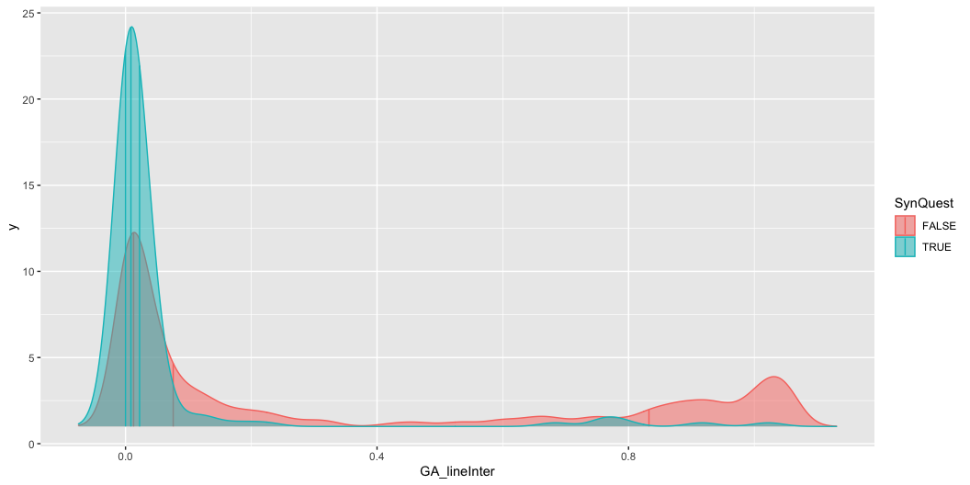
Questionnaire score: 11.00 n ID pass Quest: 184.000000 Accuracy: 0.51 Sensitivity: 0.33 Agreement: 0.51 |SynQuest | Med_Cons| SD_Cons| |:--------|--------:|-------:| |FALSE | 0.1138| 0.6606| |TRUE | 0.0868| 0.1736| |SynQuest | Med_Line| SD_Line| |:--------|--------:|-------:| |FALSE | 0.0683| 0.4092| |TRUE | 0.0044| 0.0986|

Slide 24
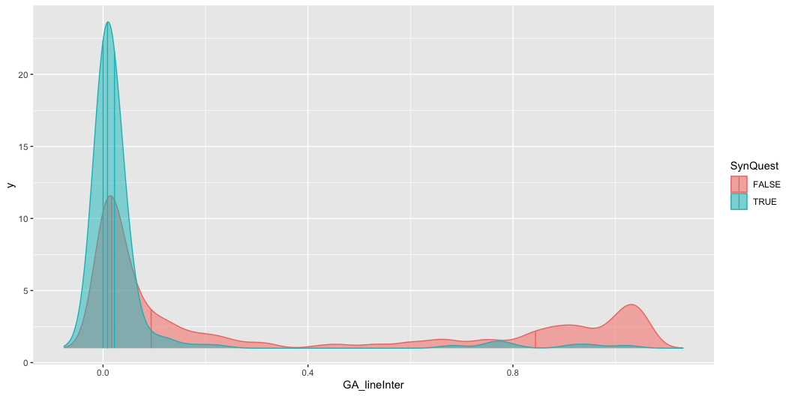
Questionnaire score: 12.00 n ID pass Quest: 206.000000 Accuracy: 0.54 Sensitivity: 0.38 Agreement: 0.54 |SynQuest | Med_Cons| SD_Cons| |:--------|--------:|-------:| |FALSE | 0.1157| 0.6783| |TRUE | 0.0892| 0.1783| |SynQuest | Med_Line| SD_Line| |:--------|--------:|-------:| |FALSE | 0.0759| 0.4122| |TRUE | 0.0086| 0.1701|

Slide 25
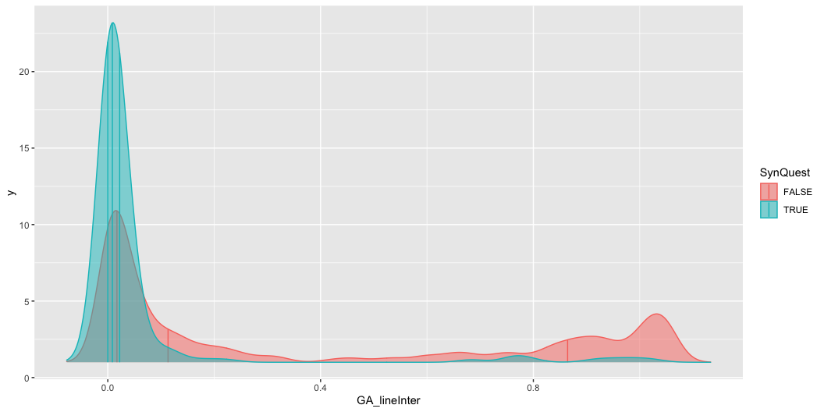
Questionnaire score: 13.00 n ID pass Quest: 224.000000 Accuracy: 0.57 Sensitivity: 0.43 Agreement: 0.57 |SynQuest | Med_Cons| SD_Cons| |:--------|--------:|-------:| |FALSE | 0.1086| 0.6952| |TRUE | 0.0976| 0.1725| |SynQuest | Med_Line| SD_Line| |:--------|--------:|-------:| |FALSE | 0.0939| 0.4154| |TRUE | 0.0086| 0.1761|

Slide 26
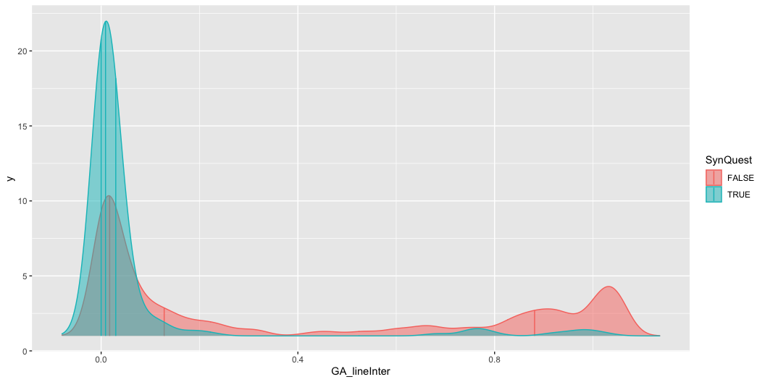
Questionnaire score: 14.00 n ID pass Quest: 241.000000 Accuracy: 0.61 Sensitivity: 0.48 Agreement: 0.61 |SynQuest | Med_Cons| SD_Cons| |:--------|--------:|-------:| |FALSE | 0.1083| 0.7115| |TRUE | 0.0990| 0.1699| |SynQuest | Med_Line| SD_Line| |:--------|--------:|-------:| |FALSE | 0.1133| 0.4179| |TRUE | 0.0086| 0.1822|

Slide 27

Questionnaire score: 15.00 n ID pass Quest: 259.000000 Accuracy: 0.64 Sensitivity: 0.53 Agreement: 0.64 |SynQuest | Med_Cons| SD_Cons| |:--------|--------:|-------:| |FALSE | 0.1072| 0.7271| |TRUE | 0.0991| 0.2036| |SynQuest | Med_Line| SD_Line| |:--------|--------:|-------:| |FALSE | 0.1282| 0.4212| |TRUE | 0.0089| 0.1931|

Slide 28

Questionnaire score: 16.00 n ID pass Quest: 268.000000 Accuracy: 0.65 Sensitivity: 0.55 Agreement: 0.65 |SynQuest | Med_Cons| SD_Cons| |:--------|--------:|-------:| |FALSE | 0.1086| 0.7368| |TRUE | 0.0991| 0.1998| |SynQuest | Med_Line| SD_Line| |:--------|--------:|-------:| |FALSE | 0.1356| 0.4224| |TRUE | 0.0089| 0.2002|

Slide 29

Questionnaire score: 17.00 n ID pass Quest: 282.000000 Accuracy: 0.67 Sensitivity: 0.59 Agreement: 0.67 |SynQuest | Med_Cons| SD_Cons| |:--------|--------:|-------:| |FALSE | 0.1169| 0.7530| |TRUE | 0.0992| 0.1951| |SynQuest | Med_Line| SD_Line| |:--------|--------:|-------:| |FALSE | 0.1526| 0.4234| |TRUE | 0.0126| 0.2159|

Slide 30
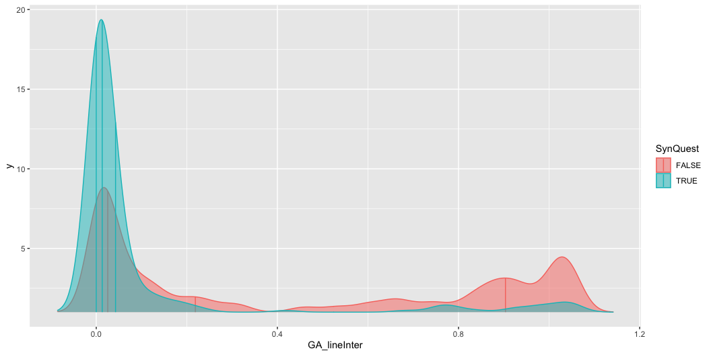
Questionnaire score: 18.00 n ID pass Quest: 299.000000 Accuracy: 0.69 Sensitivity: 0.63 Agreement: 0.69 |SynQuest | Med_Cons| SD_Cons| |:--------|--------:|-------:| |FALSE | 0.1068| 0.7731| |TRUE | 0.1003| 0.2115| |SynQuest | Med_Line| SD_Line| |:--------|--------:|-------:| |FALSE | 0.1847| 0.4227| |TRUE | 0.0128| 0.2385|

Slide 31

Questionnaire score: 19.00 n ID pass Quest: 315.000000 Accuracy: 0.71 Sensitivity: 0.66 Agreement: 0.71 |SynQuest | Med_Cons| SD_Cons| |:--------|--------:|-------:| |FALSE | 0.0966| 0.7547| |TRUE | 0.1020| 0.3378| |SynQuest | Med_Line| SD_Line| |:--------|--------:|-------:| |FALSE | 0.2188| 0.4248| |TRUE | 0.0132| 0.2445|

Slide 32
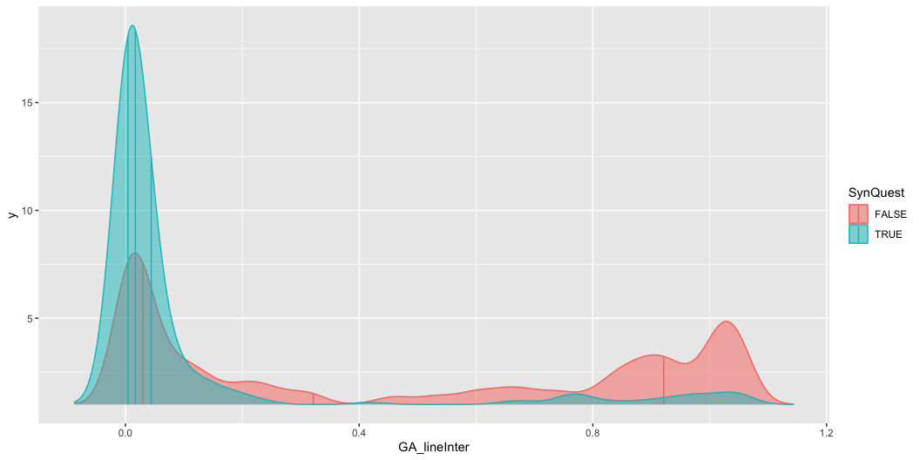
Questionnaire score: 20.00 n ID pass Quest: 328.000000 Accuracy: 0.73 Sensitivity: 0.69 Agreement: 0.73 |SynQuest | Med_Cons| SD_Cons| |:--------|--------:|-------:| |FALSE | 0.0894| 0.7245| |TRUE | 0.1022| 0.4285| |SynQuest | Med_Line| SD_Line| |:--------|--------:|-------:| |FALSE | 0.2533| 0.4262| |TRUE | 0.0134| 0.2506|

Slide 33
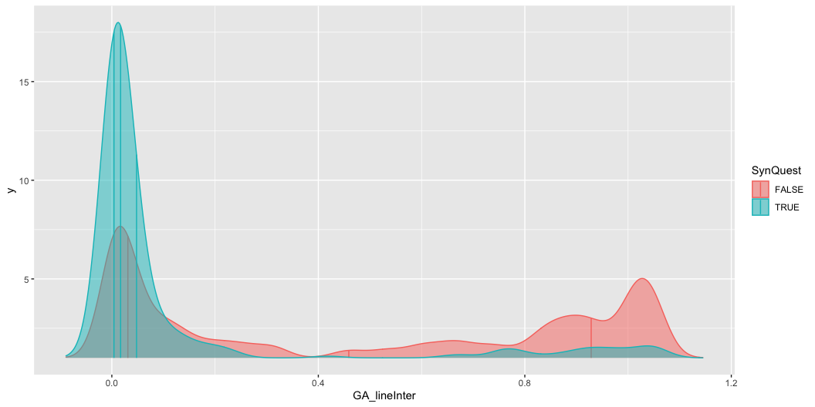
Questionnaire score: 21.00 n ID pass Quest: 340.000000 Accuracy: 0.75 Sensitivity: 0.73 Agreement: 0.75 |SynQuest | Med_Cons| SD_Cons| |:--------|--------:|-------:| |FALSE | 0.0832| 0.7423| |TRUE | 0.1038| 0.4241| |SynQuest | Med_Line| SD_Line| |:--------|--------:|-------:| |FALSE | 0.3218| 0.4268| |TRUE | 0.0169| 0.2499|

Slide 34

Questionnaire score: 22.00 n ID pass Quest: 354.000000 Accuracy: 0.76 Sensitivity: 0.76 Agreement: 0.76 |SynQuest | Med_Cons| SD_Cons| |:--------|--------:|-------:| |FALSE | 0.0859| 0.7467| |TRUE | 0.1030| 0.4413| |SynQuest | Med_Line| SD_Line| |:--------|--------:|-------:| |FALSE | 0.459| 0.4262| |TRUE | 0.017| 0.2639|

Slide 35

Questionnaire score: 23.00 n ID pass Quest: 367.000000 Accuracy: 0.78 Sensitivity: 0.78 Agreement: 0.78 |SynQuest | Med_Cons| SD_Cons| |:--------|--------:|-------:| |FALSE | 0.0830| 0.7659| |TRUE | 0.1044| 0.4402| |SynQuest | Med_Line| SD_Line| |:--------|--------:|-------:| |FALSE | 0.5396| 0.4261| |TRUE | 0.0170| 0.2687|

Slide 36
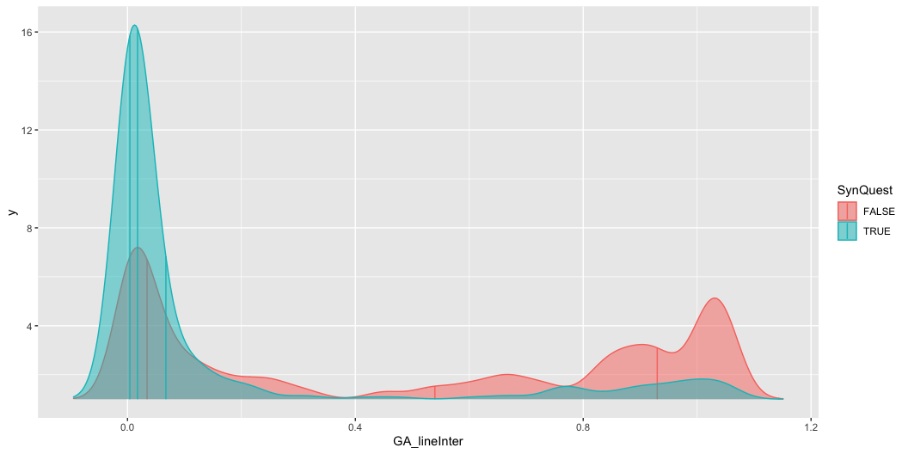
Questionnaire score: 24.00 n ID pass Quest: 373.000000 Accuracy: 0.78 Sensitivity: 0.79 Agreement: 0.78 |SynQuest | Med_Cons| SD_Cons| |:--------|--------:|-------:| |FALSE | 0.0864| 0.7667| |TRUE | 0.1029| 0.4484| |SynQuest | Med_Line| SD_Line| |:--------|--------:|-------:| |FALSE | 0.5396| 0.4252| |TRUE | 0.0173| 0.2791|

Slide 37
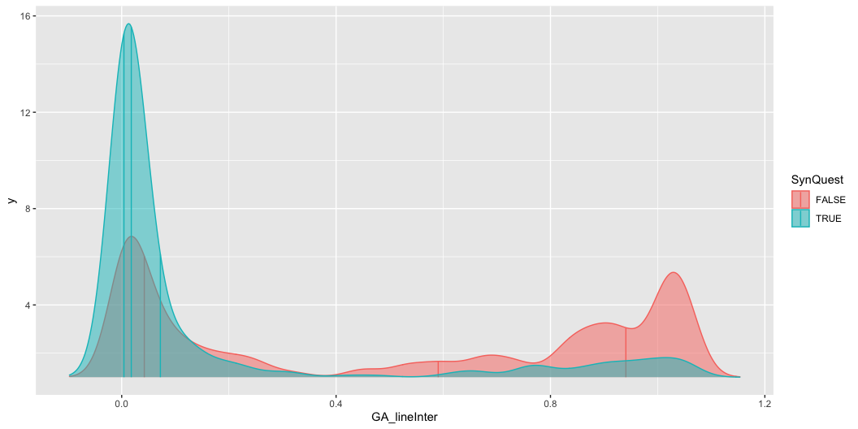
Questionnaire score: 25.00 n ID pass Quest: 385.000000 Accuracy: 0.76 Sensitivity: 0.80 Agreement: 0.76 |SynQuest | Med_Cons| SD_Cons| |:--------|--------:|-------:| |FALSE | 0.0846| 0.7246| |TRUE | 0.1032| 0.5009| |SynQuest | Med_Line| SD_Line| |:--------|--------:|-------:| |FALSE | 0.5396| 0.4282| |TRUE | 0.0177| 0.2950|

Slide 38
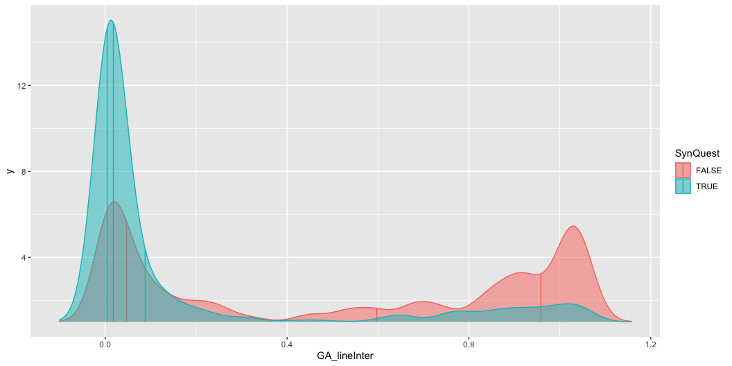
Questionnaire score: 26.00 n ID pass Quest: 399.000000 Accuracy: 0.76 Sensitivity: 0.82 Agreement: 0.76 |SynQuest | Med_Cons| SD_Cons| |:--------|--------:|-------:| |FALSE | 0.0864| 0.7173| |TRUE | 0.1029| 0.5185| |SynQuest | Med_Line| SD_Line| |:--------|--------:|-------:| |FALSE | 0.5906| 0.4303| |TRUE | 0.0179| 0.3018|

Slide 39
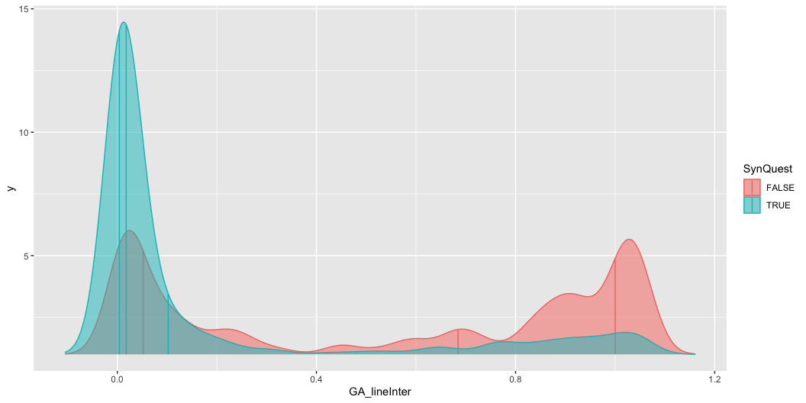
Questionnaire score: 27.00 n ID pass Quest: 410.000000 Accuracy: 0.77 Sensitivity: 0.84 Agreement: 0.77 |SynQuest | Med_Cons| SD_Cons| |:--------|--------:|-------:| |FALSE | 0.0859| 0.7149| |TRUE | 0.1026| 0.5279| |SynQuest | Med_Line| SD_Line| |:--------|--------:|-------:| |FALSE | 0.5975| 0.4310| |TRUE | 0.0179| 0.3092|

Slide 40
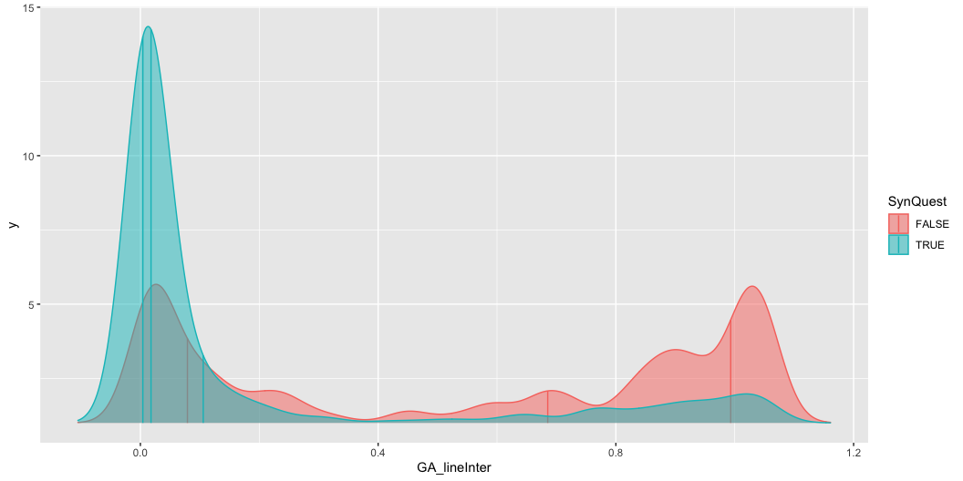
Questionnaire score: 28.00 n ID pass Quest: 426.000000 Accuracy: 0.78 Sensitivity: 0.87 Agreement: 0.78 |SynQuest | Med_Cons| SD_Cons| |:--------|--------:|-------:| |FALSE | 0.0676| 0.7407| |TRUE | 0.1030| 0.5267| |SynQuest | Med_Line| SD_Line| |:--------|--------:|-------:| |FALSE | 0.6843| 0.4276| |TRUE | 0.0179| 0.3156|

Slide 41

Questionnaire score: 29.00 n ID pass Quest: 433.000000 Accuracy: 0.78 Sensitivity: 0.88 Agreement: 0.78 |SynQuest | Med_Cons| SD_Cons| |:--------|--------:|-------:| |FALSE | 0.0752| 0.7598| |TRUE | 0.1029| 0.5224| |SynQuest | Med_Line| SD_Line| |:--------|--------:|-------:| |FALSE | 0.6853| 0.4226| |TRUE | 0.0179| 0.3217|

Slide 42
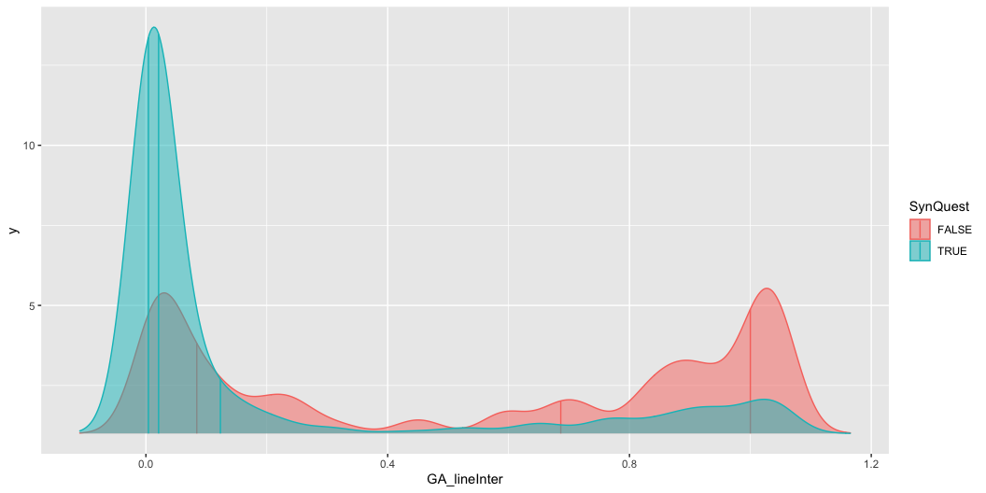
Questionnaire score: 30.00 n ID pass Quest: 440.000000 Accuracy: 0.78 Sensitivity: 0.89 Agreement: 0.78 |SynQuest | Med_Cons| SD_Cons| |:--------|--------:|-------:| |FALSE | 0.0625| 0.7451| |TRUE | 0.1030| 0.5353| |SynQuest | Med_Line| SD_Line| |:--------|--------:|-------:| |FALSE | 0.6863| 0.4211| |TRUE | 0.0209| 0.3281|

Slide 43
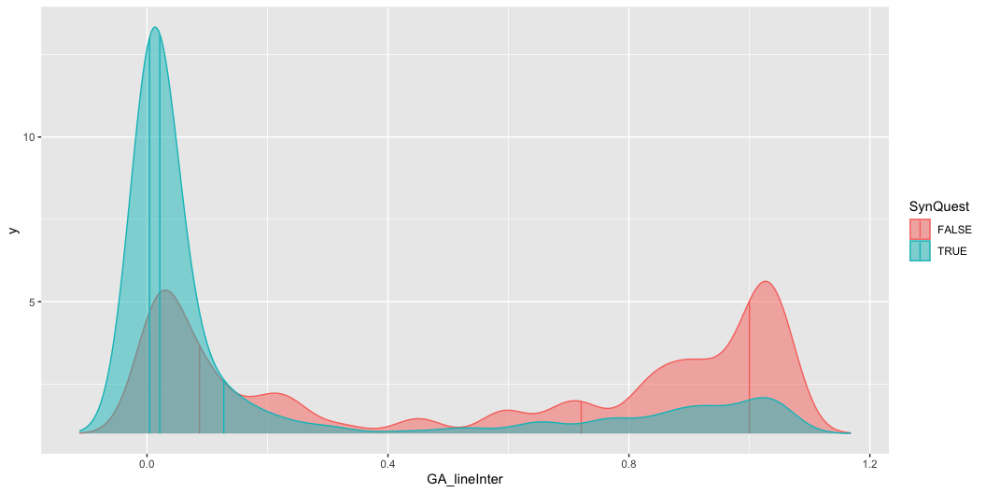
Questionnaire score: 31.00 n ID pass Quest: 446.000000 Accuracy: 0.77 Sensitivity: 0.90 Agreement: 0.77 |SynQuest | Med_Cons| SD_Cons| |:--------|--------:|-------:| |FALSE | 0.0466| 0.7660| |TRUE | 0.1038| 0.5314| |SynQuest | Med_Line| SD_Line| |:--------|--------:|-------:| |FALSE | 0.6863| 0.4211| |TRUE | 0.0210| 0.3337|

Slide 44

Questionnaire score: 32.00 n ID pass Quest: 453.000000 Accuracy: 0.77 Sensitivity: 0.91 Agreement: 0.77 |SynQuest | Med_Cons| SD_Cons| |:--------|--------:|-------:| |FALSE | 0.0453| 0.6961| |TRUE | 0.1052| 0.5599| |SynQuest | Med_Line| SD_Line| |:--------|--------:|-------:| |FALSE | 0.7209| 0.4220| |TRUE | 0.0213| 0.3364|

Slide 45
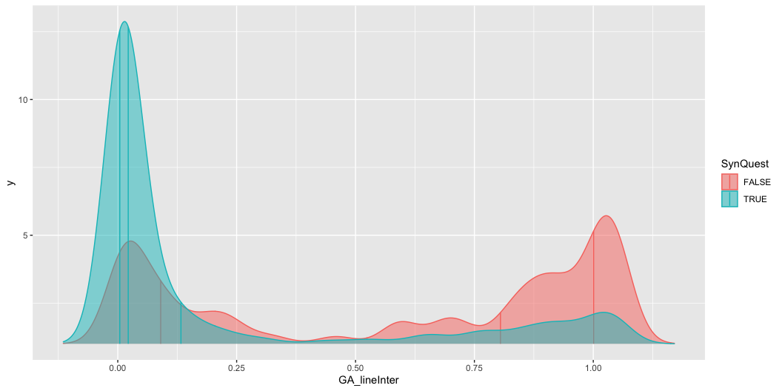
Questionnaire score: 33.00 n ID pass Quest: 457.000000 Accuracy: 0.76 Sensitivity: 0.91 Agreement: 0.76 |SynQuest | Med_Cons| SD_Cons| |:--------|--------:|-------:| |FALSE | 0.0459| 0.7088| |TRUE | 0.1044| 0.5575| |SynQuest | Med_Line| SD_Line| |:--------|--------:|-------:| |FALSE | 0.7209| 0.4243| |TRUE | 0.0213| 0.3391|

Slide 46
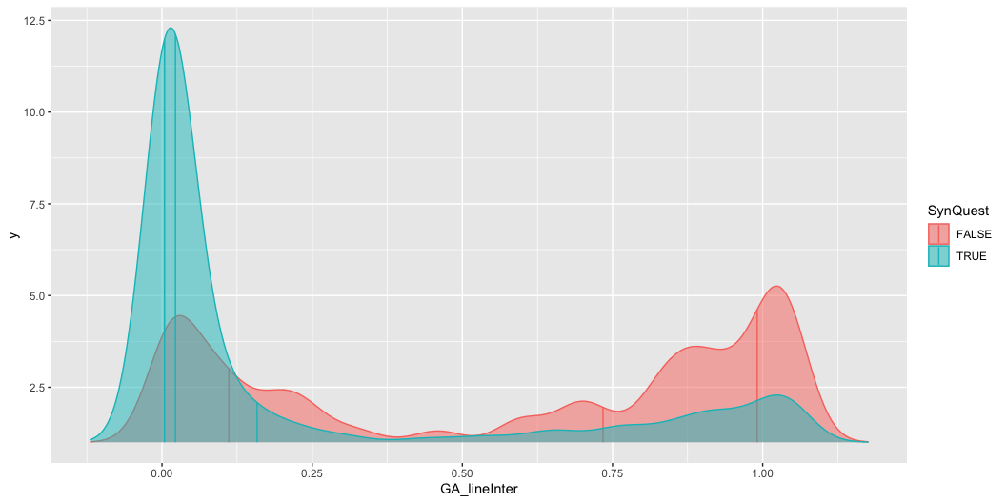
Questionnaire score: 34.00 n ID pass Quest: 466.000000 Accuracy: 0.77 Sensitivity: 0.93 Agreement: 0.77 |SynQuest | Med_Cons| SD_Cons| |:--------|--------:|-------:| |FALSE | 0.0453| 0.6512| |TRUE | 0.1048| 0.5755| |SynQuest | Med_Line| SD_Line| |:--------|--------:|-------:| |FALSE | 0.8048| 0.4184| |TRUE | 0.0220| 0.3420|

Slide 47
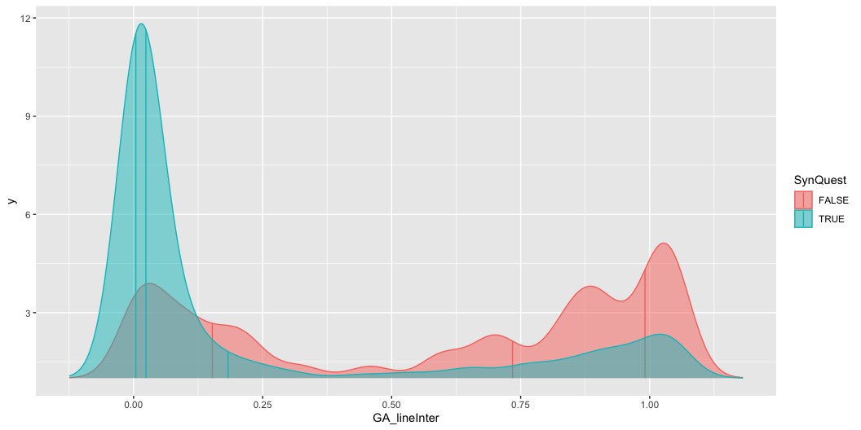
Questionnaire score: 35.00 n ID pass Quest: 478.000000 Accuracy: 0.76 Sensitivity: 0.94 Agreement: 0.76 |SynQuest | Med_Cons| SD_Cons| |:--------|--------:|-------:| |FALSE | 0.0529| 0.6949| |TRUE | 0.1030| 0.5690| |SynQuest | Med_Line| SD_Line| |:--------|--------:|-------:| |FALSE | 0.7342| 0.4102| |TRUE | 0.0223| 0.3539|

Slide 48
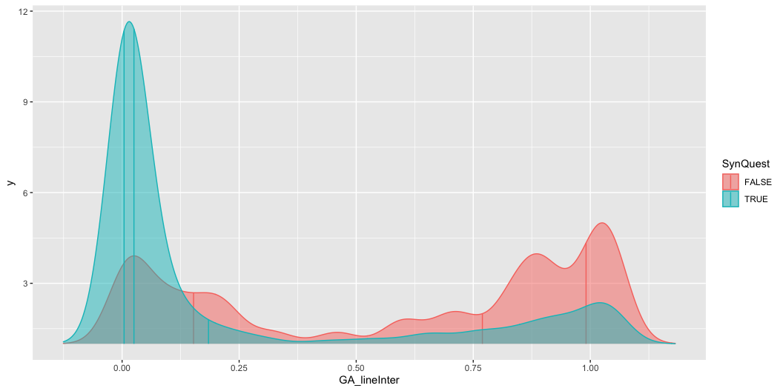
Questionnaire score: 36.00 n ID pass Quest: 488.000000 Accuracy: 0.76 Sensitivity: 0.95 Agreement: 0.76 |SynQuest | Med_Cons| SD_Cons| |:--------|--------:|-------:| |FALSE | 0.0529| 0.6975| |TRUE | 0.1030| 0.5726| |SynQuest | Med_Line| SD_Line| |:--------|--------:|-------:| |FALSE | 0.7342| 0.4015| |TRUE | 0.0238| 0.3594|

Slide 49
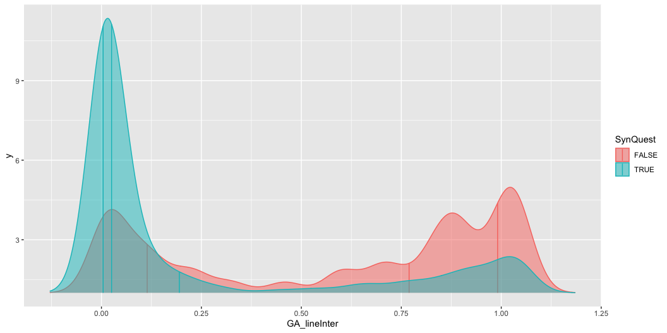
Questionnaire score: 37.00 n ID pass Quest: 491.000000 Accuracy: 0.76 Sensitivity: 0.95 Agreement: 0.76 |SynQuest | Med_Cons| SD_Cons| |:--------|--------:|-------:| |FALSE | 0.0497| 0.7152| |TRUE | 0.1032| 0.5711| |SynQuest | Med_Line| SD_Line| |:--------|--------:|-------:| |FALSE | 0.7695| 0.4019| |TRUE | 0.0253| 0.3611|

Slide 50

Questionnaire score: 38.00 n ID pass Quest: 495.000000 Accuracy: 0.76 Sensitivity: 0.96 Agreement: 0.76 |SynQuest | Med_Cons| SD_Cons| |:--------|--------:|-------:| |FALSE | 0.0497| 0.6812| |TRUE | 0.1032| 0.5774| |SynQuest | Med_Line| SD_Line| |:--------|--------:|-------:| |FALSE | 0.7695| 0.4018| |TRUE | 0.0254| 0.3633|

Slide 51
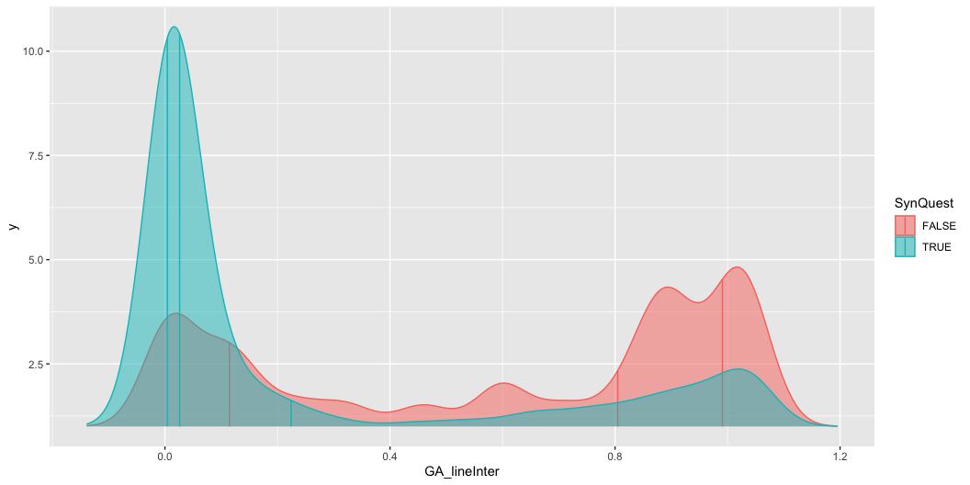
Questionnaire score: 39.00 n ID pass Quest: 501.000000 Accuracy: 0.75 Sensitivity: 0.96 Agreement: 0.75 |SynQuest | Med_Cons| SD_Cons| |:--------|--------:|-------:| |FALSE | 0.0545| 0.7206| |TRUE | 0.1029| 0.5740| |SynQuest | Med_Line| SD_Line| |:--------|--------:|-------:| |FALSE | 0.7695| 0.4034| |TRUE | 0.0257| 0.3671|

Slide 52
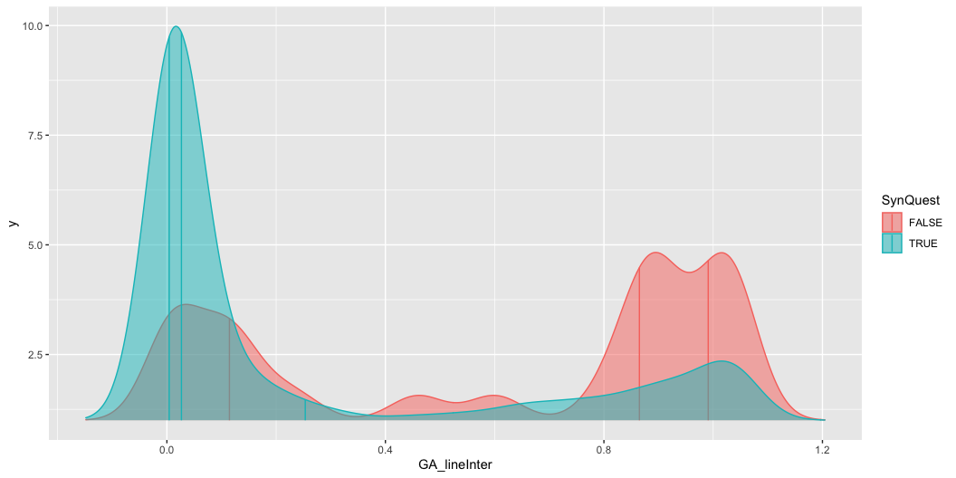
Questionnaire score: 40.00 n ID pass Quest: 506.000000 Accuracy: 0.75 Sensitivity: 0.97 Agreement: 0.75 |SynQuest | Med_Cons| SD_Cons| |:--------|--------:|-------:| |FALSE | 0.0466| 0.7022| |TRUE | 0.1030| 0.5785| |SynQuest | Med_Line| SD_Line| |:--------|--------:|-------:| |FALSE | 0.8048| 0.4012| |TRUE | 0.0261| 0.3689|

Slide 53
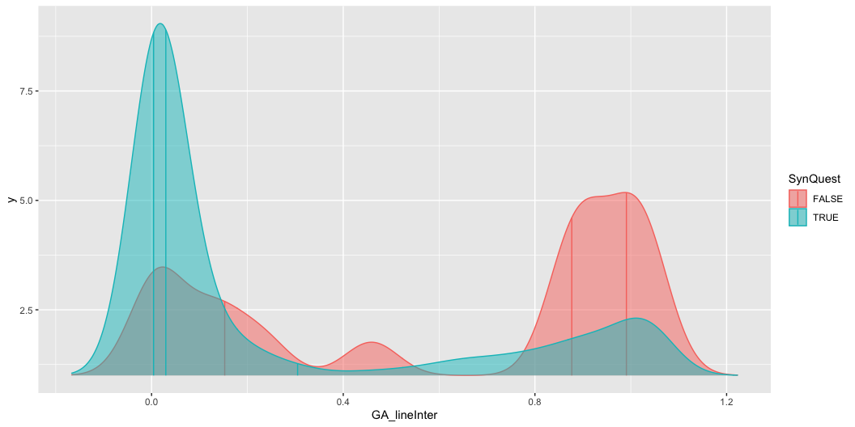
Questionnaire score: 41.00 n ID pass Quest: 511.000000 Accuracy: 0.74 Sensitivity: 0.97 Agreement: 0.74 |SynQuest | Med_Cons| SD_Cons| |:--------|--------:|-------:| |FALSE | 0.0417| 0.7274| |TRUE | 0.1032| 0.5787| |SynQuest | Med_Line| SD_Line| |:--------|--------:|-------:| |FALSE | 0.8649| 0.4099| |TRUE | 0.0266| 0.3700|

Slide 54
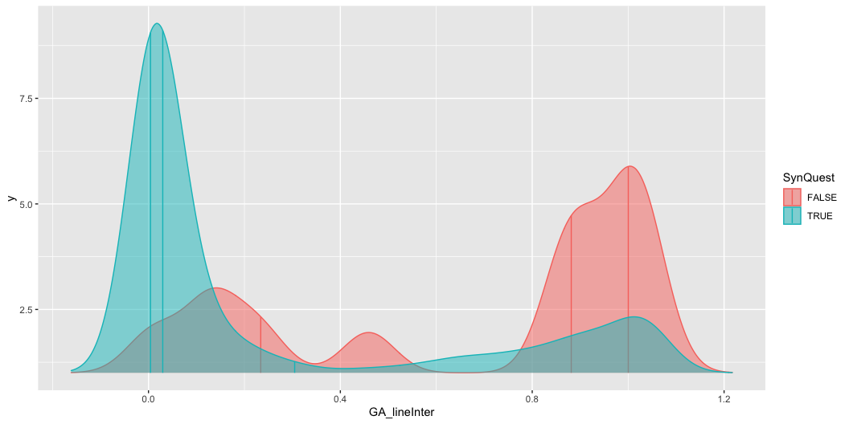
Questionnaire score: 42.00 n ID pass Quest: 520.000000 Accuracy: 0.74 Sensitivity: 0.98 Agreement: 0.74 |SynQuest | Med_Cons| SD_Cons| |:--------|--------:|-------:| |FALSE | 0.0098| 0.7709| |TRUE | 0.1026| 0.5799| |SynQuest | Med_Line| SD_Line| |:--------|--------:|-------:| |FALSE | 0.8769| 0.4152| |TRUE | 0.0297| 0.3742|

Slide 55
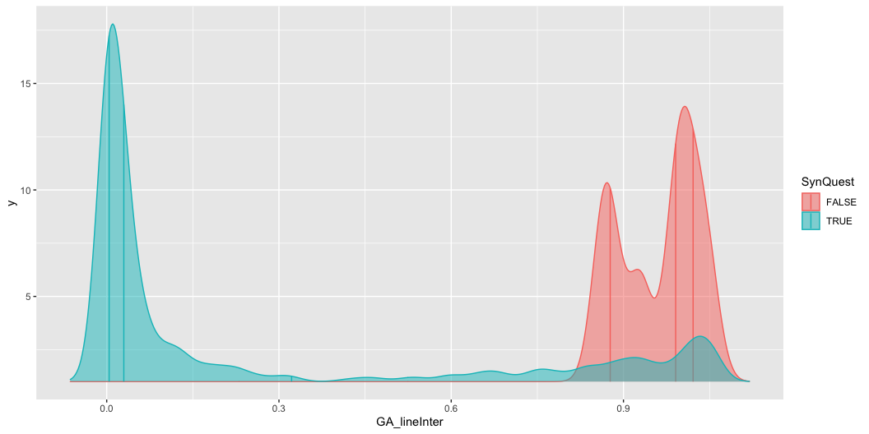
Questionnaire score: 43.00 n ID pass Quest: 523.000000 Accuracy: 0.74 Sensitivity: 0.99 Agreement: 0.74 |SynQuest | Med_Cons| SD_Cons| |:--------|--------:|-------:| |FALSE | 0.0049| 0.8318| |TRUE | 0.1024| 0.5783| |SynQuest | Med_Line| SD_Line| |:--------|--------:|-------:| |FALSE | 0.8814| 0.3825| |TRUE | 0.0297| 0.3746|

Slide 56
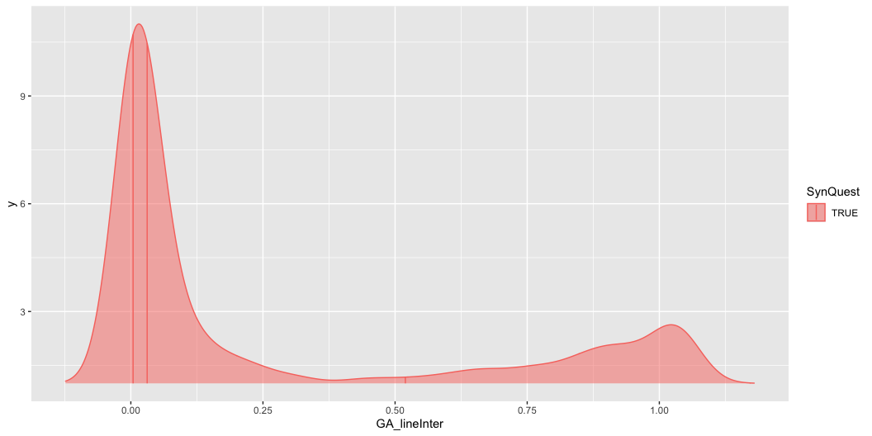
Questionnaire score: 44.00 n ID pass Quest: 530.000000 Accuracy: 0.74 Sensitivity: 1.00 Agreement: 0.74 |SynQuest | Med_Cons| SD_Cons| |:--------|--------:|-------:| |FALSE | 0.000| 0.0069| |TRUE | 0.103| 0.5919| |SynQuest | Med_Line| SD_Line| |:--------|--------:|-------:| |FALSE | 0.9909| 0.0666| |TRUE | 0.0298| 0.3750|

Slide 57
Consistency

Slide 58
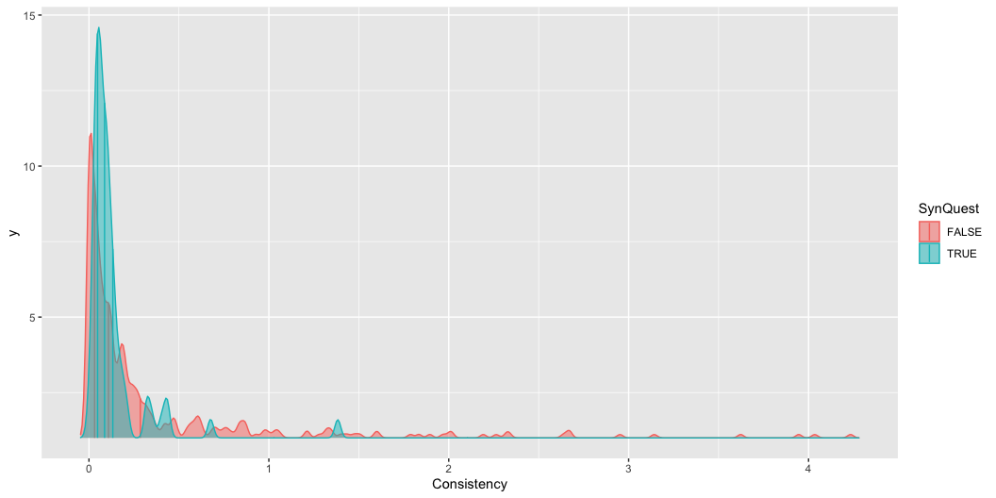

Slide 59
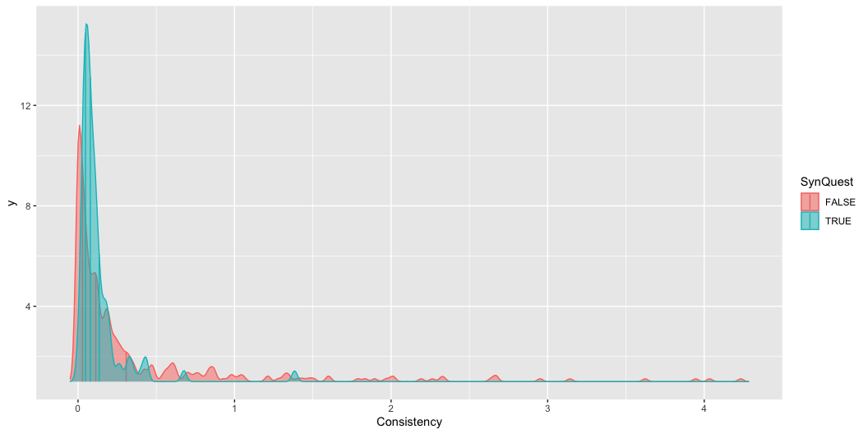
Questionnaire score: 9.00 n ID pass Quest: 142.000000 Accuracy: 0.55 Sensitivity: 0.68 Agreement: 0.55 |SynQuest | Med_Cons| SD_Cons| |:--------|--------:|-------:| |FALSE | 0.1086| 0.6301| |TRUE | 0.0868| 0.1877| |SynQuest | Med_Line| SD_Line| |:--------|--------:|-------:| |FALSE | 0.0469| 0.3997| |TRUE | 0.0043| 0.0818|

Slide 60
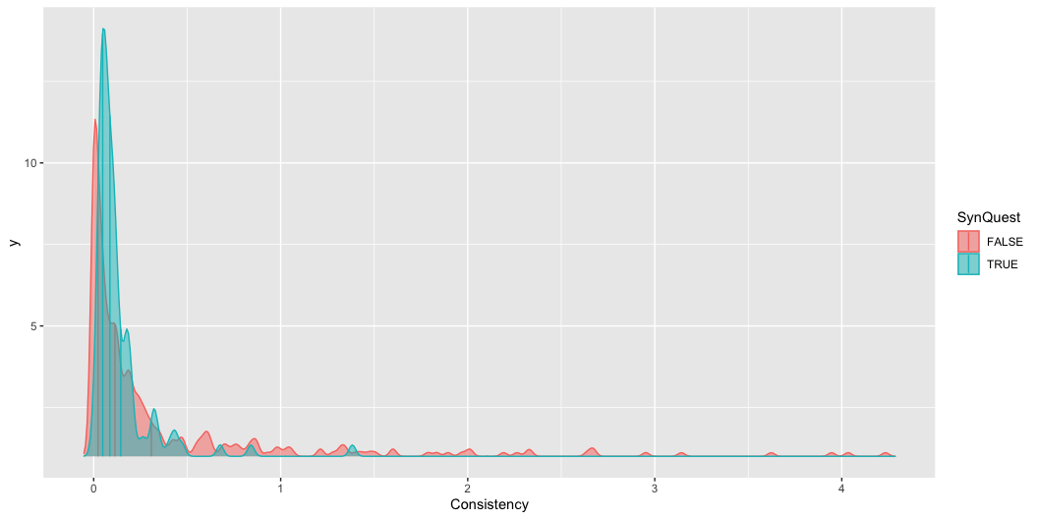
Questionnaire score: 10.00 n ID pass Quest: 165.000000 Accuracy: 0.55 Sensitivity: 0.68 Agreement: 0.55 |SynQuest | Med_Cons| SD_Cons| |:--------|--------:|-------:| |FALSE | 0.1135| 0.6463| |TRUE | 0.0786| 0.1677| |SynQuest | Med_Line| SD_Line| |:--------|--------:|-------:| |FALSE | 0.0592| 0.4050| |TRUE | 0.0043| 0.0718|

Slide 61
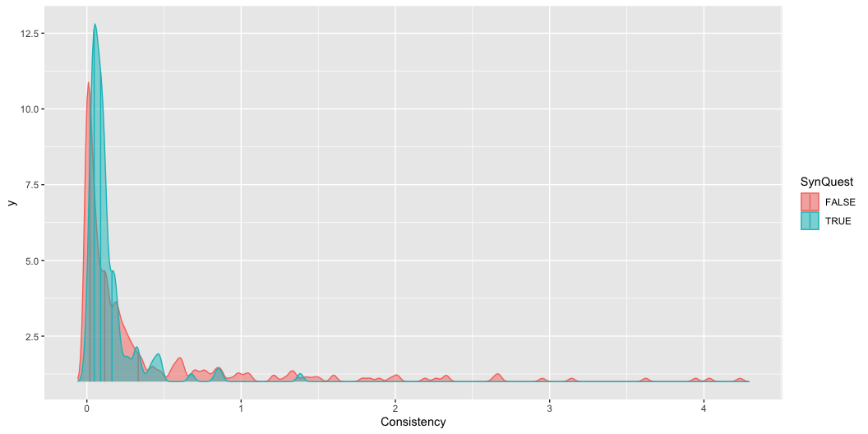
Questionnaire score: 11.00 n ID pass Quest: 184.000000 Accuracy: 0.55 Sensitivity: 0.68 Agreement: 0.55 |SynQuest | Med_Cons| SD_Cons| |:--------|--------:|-------:| |FALSE | 0.1138| 0.6606| |TRUE | 0.0868| 0.1736| |SynQuest | Med_Line| SD_Line| |:--------|--------:|-------:| |FALSE | 0.0683| 0.4092| |TRUE | 0.0044| 0.0986|

Slide 62
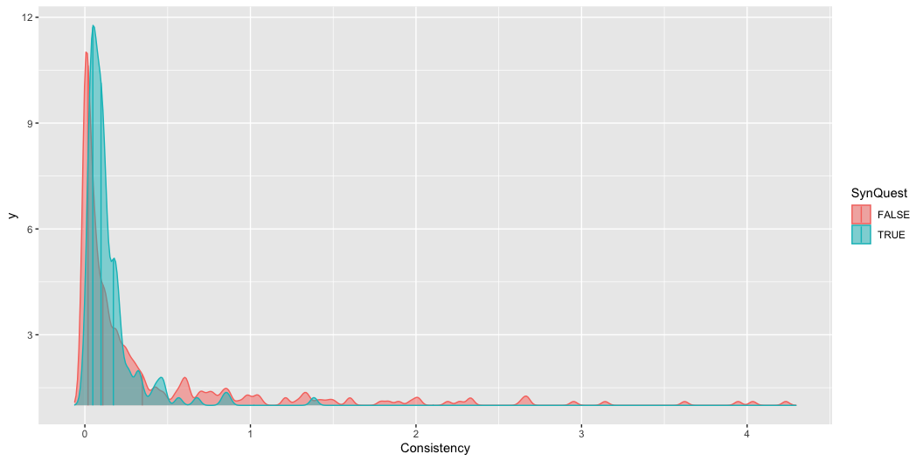
Questionnaire score: 12.00 n ID pass Quest: 206.000000 Accuracy: 0.55 Sensitivity: 0.68 Agreement: 0.55 |SynQuest | Med_Cons| SD_Cons| |:--------|--------:|-------:| |FALSE | 0.1157| 0.6783| |TRUE | 0.0892| 0.1783| |SynQuest | Med_Line| SD_Line| |:--------|--------:|-------:| |FALSE | 0.0759| 0.4122| |TRUE | 0.0086| 0.1701|

Slide 63
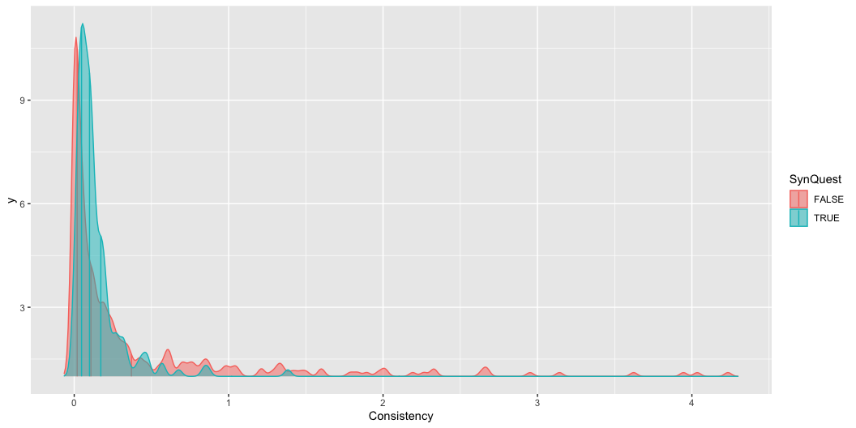
Questionnaire score: 13.00 n ID pass Quest: 224.000000 Accuracy: 0.55 Sensitivity: 0.68 Agreement: 0.55 |SynQuest | Med_Cons| SD_Cons| |:--------|--------:|-------:| |FALSE | 0.1086| 0.6952| |TRUE | 0.0976| 0.1725| |SynQuest | Med_Line| SD_Line| |:--------|--------:|-------:| |FALSE | 0.0939| 0.4154| |TRUE | 0.0086| 0.1761|

Slide 64

Questionnaire score: 14.00 n ID pass Quest: 241.000000 Accuracy: 0.55 Sensitivity: 0.68 Agreement: 0.55 |SynQuest | Med_Cons| SD_Cons| |:--------|--------:|-------:| |FALSE | 0.1083| 0.7115| |TRUE | 0.0990| 0.1699| |SynQuest | Med_Line| SD_Line| |:--------|--------:|-------:| |FALSE | 0.1133| 0.4179| |TRUE | 0.0086| 0.1822|

Slide 65
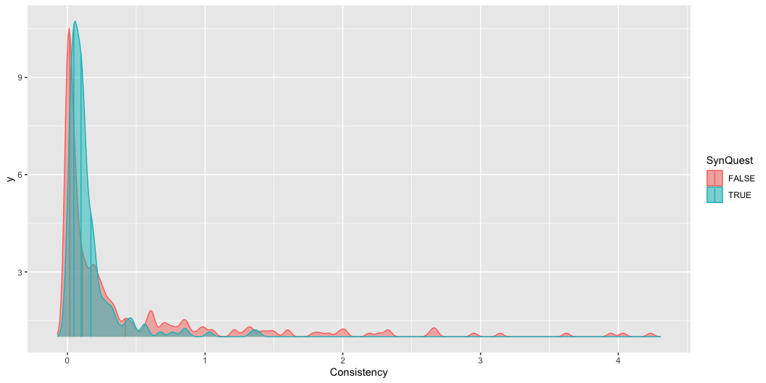
Questionnaire score: 15.00 n ID pass Quest: 259.000000 Accuracy: 0.55 Sensitivity: 0.68 Agreement: 0.55 |SynQuest | Med_Cons| SD_Cons| |:--------|--------:|-------:| |FALSE | 0.1072| 0.7271| |TRUE | 0.0991| 0.2036| |SynQuest | Med_Line| SD_Line| |:--------|--------:|-------:| |FALSE | 0.1282| 0.4212| |TRUE | 0.0089| 0.1931|

Slide 66
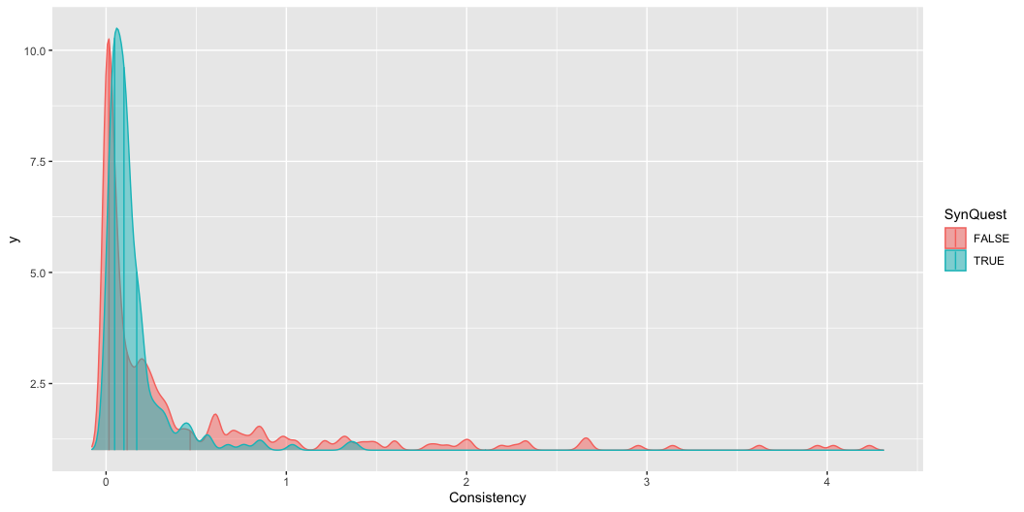
Questionnaire score: 16.00 n ID pass Quest: 268.000000 Accuracy: 0.55 Sensitivity: 0.68 Agreement: 0.55 |SynQuest | Med_Cons| SD_Cons| |:--------|--------:|-------:| |FALSE | 0.1086| 0.7368| |TRUE | 0.0991| 0.1998| |SynQuest | Med_Line| SD_Line| |:--------|--------:|-------:| |FALSE | 0.1356| 0.4224| |TRUE | 0.0089| 0.2002|

Slide 67

Questionnaire score: 17.00 n ID pass Quest: 282.000000 Accuracy: 0.55 Sensitivity: 0.68 Agreement: 0.55 |SynQuest | Med_Cons| SD_Cons| |:--------|--------:|-------:| |FALSE | 0.1169| 0.7530| |TRUE | 0.0992| 0.1951| |SynQuest | Med_Line| SD_Line| |:--------|--------:|-------:| |FALSE | 0.1526| 0.4234| |TRUE | 0.0126| 0.2159|

Slide 68
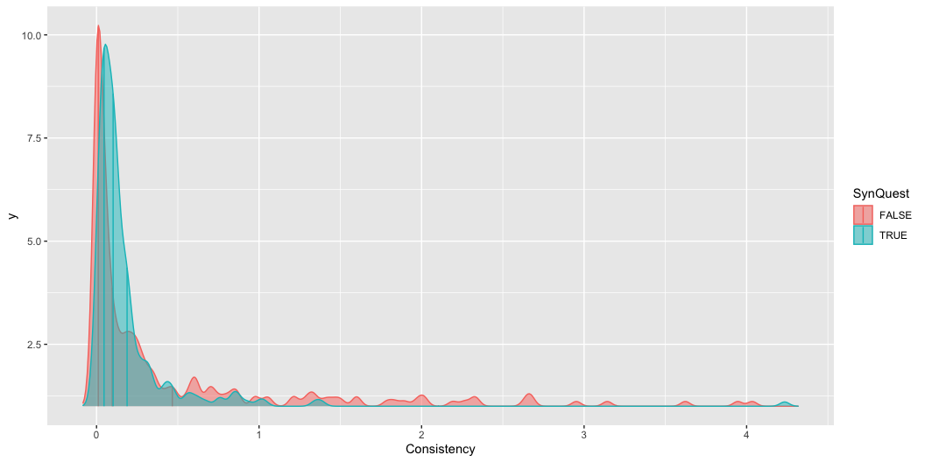
Questionnaire score: 18.00 n ID pass Quest: 299.000000 Accuracy: 0.55 Sensitivity: 0.68 Agreement: 0.55 |SynQuest | Med_Cons| SD_Cons| |:--------|--------:|-------:| |FALSE | 0.1068| 0.7731| |TRUE | 0.1003| 0.2115| |SynQuest | Med_Line| SD_Line| |:--------|--------:|-------:| |FALSE | 0.1847| 0.4227| |TRUE | 0.0128| 0.2385|

Slide 69
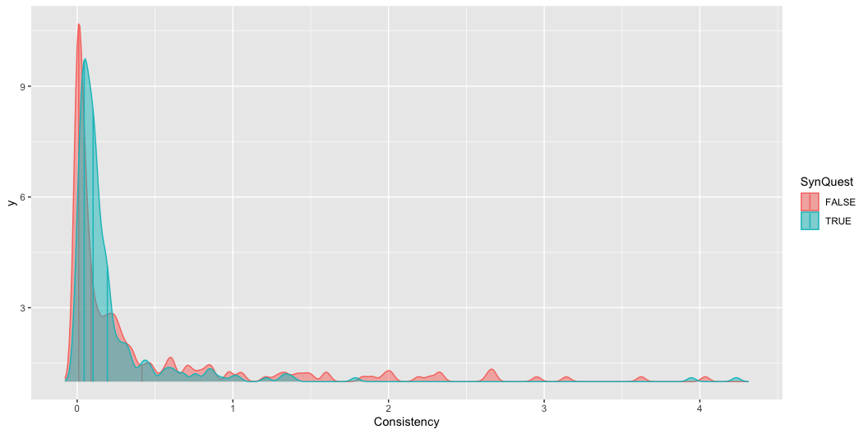
Questionnaire score: 19.00 n ID pass Quest: 315.000000 Accuracy: 0.55 Sensitivity: 0.68 Agreement: 0.55 |SynQuest | Med_Cons| SD_Cons| |:--------|--------:|-------:| |FALSE | 0.0966| 0.7547| |TRUE | 0.1020| 0.3378| |SynQuest | Med_Line| SD_Line| |:--------|--------:|-------:| |FALSE | 0.2188| 0.4248| |TRUE | 0.0132| 0.2445|

Slide 70

Questionnaire score: 20.00 n ID pass Quest: 328.000000 Accuracy: 0.55 Sensitivity: 0.68 Agreement: 0.55 |SynQuest | Med_Cons| SD_Cons| |:--------|--------:|-------:| |FALSE | 0.0894| 0.7245| |TRUE | 0.1022| 0.4285| |SynQuest | Med_Line| SD_Line| |:--------|--------:|-------:| |FALSE | 0.2533| 0.4262| |TRUE | 0.0134| 0.2506|

Slide 71

Questionnaire score: 21.00 n ID pass Quest: 340.000000 Accuracy: 0.55 Sensitivity: 0.68 Agreement: 0.55 |SynQuest | Med_Cons| SD_Cons| |:--------|--------:|-------:| |FALSE | 0.0832| 0.7423| |TRUE | 0.1038| 0.4241| |SynQuest | Med_Line| SD_Line| |:--------|--------:|-------:| |FALSE | 0.3218| 0.4268| |TRUE | 0.0169| 0.2499|

Slide 72

Questionnaire score: 22.00 n ID pass Quest: 354.000000 Accuracy: 0.55 Sensitivity: 0.68 Agreement: 0.55 |SynQuest | Med_Cons| SD_Cons| |:--------|--------:|-------:| |FALSE | 0.0859| 0.7467| |TRUE | 0.1030| 0.4413| |SynQuest | Med_Line| SD_Line| |:--------|--------:|-------:| |FALSE | 0.459| 0.4262| |TRUE | 0.017| 0.2639|

Slide 73

Questionnaire score: 23.00 n ID pass Quest: 367.000000 Accuracy: 0.55 Sensitivity: 0.68 Agreement: 0.55 |SynQuest | Med_Cons| SD_Cons| |:--------|--------:|-------:| |FALSE | 0.0830| 0.7659| |TRUE | 0.1044| 0.4402| |SynQuest | Med_Line| SD_Line| |:--------|--------:|-------:| |FALSE | 0.5396| 0.4261| |TRUE | 0.0170| 0.2687|

Slide 74

Questionnaire score: 24.00 n ID pass Quest: 373.000000 Accuracy: 0.55 Sensitivity: 0.68 Agreement: 0.55 |SynQuest | Med_Cons| SD_Cons| |:--------|--------:|-------:| |FALSE | 0.0864| 0.7667| |TRUE | 0.1029| 0.4484| |SynQuest | Med_Line| SD_Line| |:--------|--------:|-------:| |FALSE | 0.5396| 0.4252| |TRUE | 0.0173| 0.2791|

Slide 75

Questionnaire score: 25.00 n ID pass Quest: 385.000000 Accuracy: 0.55 Sensitivity: 0.68 Agreement: 0.55 |SynQuest | Med_Cons| SD_Cons| |:--------|--------:|-------:| |FALSE | 0.0846| 0.7246| |TRUE | 0.1032| 0.5009| |SynQuest | Med_Line| SD_Line| |:--------|--------:|-------:| |FALSE | 0.5396| 0.4282| |TRUE | 0.0177| 0.2950|

Slide 76

Questionnaire score: 26.00 n ID pass Quest: 399.000000 Accuracy: 0.55 Sensitivity: 0.68 Agreement: 0.55 |SynQuest | Med_Cons| SD_Cons| |:--------|--------:|-------:| |FALSE | 0.0864| 0.7173| |TRUE | 0.1029| 0.5185| |SynQuest | Med_Line| SD_Line| |:--------|--------:|-------:| |FALSE | 0.5906| 0.4303| |TRUE | 0.0179| 0.3018|

Slide 77

Questionnaire score: 27.00 n ID pass Quest: 410.000000 Accuracy: 0.55 Sensitivity: 0.68 Agreement: 0.55 |SynQuest | Med_Cons| SD_Cons| |:--------|--------:|-------:| |FALSE | 0.0859| 0.7149| |TRUE | 0.1026| 0.5279| |SynQuest | Med_Line| SD_Line| |:--------|--------:|-------:| |FALSE | 0.5975| 0.4310| |TRUE | 0.0179| 0.3092|

Slide 78

Questionnaire score: 28.00 n ID pass Quest: 426.000000 Accuracy: 0.55 Sensitivity: 0.68 Agreement: 0.55 |SynQuest | Med_Cons| SD_Cons| |:--------|--------:|-------:| |FALSE | 0.0676| 0.7407| |TRUE | 0.1030| 0.5267| |SynQuest | Med_Line| SD_Line| |:--------|--------:|-------:| |FALSE | 0.6843| 0.4276| |TRUE | 0.0179| 0.3156|

Slide 79

Questionnaire score: 29.00 n ID pass Quest: 433.000000 Accuracy: 0.55 Sensitivity: 0.68 Agreement: 0.55 |SynQuest | Med_Cons| SD_Cons| |:--------|--------:|-------:| |FALSE | 0.0752| 0.7598| |TRUE | 0.1029| 0.5224| |SynQuest | Med_Line| SD_Line| |:--------|--------:|-------:| |FALSE | 0.6853| 0.4226| |TRUE | 0.0179| 0.3217|

Slide 80

Questionnaire score: 30.00 n ID pass Quest: 440.000000 Accuracy: 0.55 Sensitivity: 0.68 Agreement: 0.55 |SynQuest | Med_Cons| SD_Cons| |:--------|--------:|-------:| |FALSE | 0.0625| 0.7451| |TRUE | 0.1030| 0.5353| |SynQuest | Med_Line| SD_Line| |:--------|--------:|-------:| |FALSE | 0.6863| 0.4211| |TRUE | 0.0209| 0.3281|

Slide 81

Questionnaire score: 31.00 n ID pass Quest: 446.000000 Accuracy: 0.55 Sensitivity: 0.68 Agreement: 0.55 |SynQuest | Med_Cons| SD_Cons| |:--------|--------:|-------:| |FALSE | 0.0466| 0.7660| |TRUE | 0.1038| 0.5314| |SynQuest | Med_Line| SD_Line| |:--------|--------:|-------:| |FALSE | 0.6863| 0.4211| |TRUE | 0.0210| 0.3337|

Slide 82

Questionnaire score: 32.00 n ID pass Quest: 453.000000 Accuracy: 0.55 Sensitivity: 0.68 Agreement: 0.55 |SynQuest | Med_Cons| SD_Cons| |:--------|--------:|-------:| |FALSE | 0.0453| 0.6961| |TRUE | 0.1052| 0.5599| |SynQuest | Med_Line| SD_Line| |:--------|--------:|-------:| |FALSE | 0.7209| 0.4220| |TRUE | 0.0213| 0.3364|

Slide 83

Questionnaire score: 33.00 n ID pass Quest: 457.000000 Accuracy: 0.55 Sensitivity: 0.68 Agreement: 0.55 |SynQuest | Med_Cons| SD_Cons| |:--------|--------:|-------:| |FALSE | 0.0459| 0.7088| |TRUE | 0.1044| 0.5575| |SynQuest | Med_Line| SD_Line| |:--------|--------:|-------:| |FALSE | 0.7209| 0.4243| |TRUE | 0.0213| 0.3391|

Slide 84

Questionnaire score: 34.00 n ID pass Quest: 466.000000 Accuracy: 0.55 Sensitivity: 0.68 Agreement: 0.55 |SynQuest | Med_Cons| SD_Cons| |:--------|--------:|-------:| |FALSE | 0.0453| 0.6512| |TRUE | 0.1048| 0.5755| |SynQuest | Med_Line| SD_Line| |:--------|--------:|-------:| |FALSE | 0.8048| 0.4184| |TRUE | 0.0220| 0.3420|

Slide 85

Questionnaire score: 35.00 n ID pass Quest: 478.000000 Accuracy: 0.55 Sensitivity: 0.68 Agreement: 0.55 |SynQuest | Med_Cons| SD_Cons| |:--------|--------:|-------:| |FALSE | 0.0529| 0.6949| |TRUE | 0.1030| 0.5690| |SynQuest | Med_Line| SD_Line| |:--------|--------:|-------:| |FALSE | 0.7342| 0.4102| |TRUE | 0.0223| 0.3539|

Slide 86

Questionnaire score: 36.00 n ID pass Quest: 488.000000 Accuracy: 0.55 Sensitivity: 0.68 Agreement: 0.55 |SynQuest | Med_Cons| SD_Cons| |:--------|--------:|-------:| |FALSE | 0.0529| 0.6975| |TRUE | 0.1030| 0.5726| |SynQuest | Med_Line| SD_Line| |:--------|--------:|-------:| |FALSE | 0.7342| 0.4015| |TRUE | 0.0238| 0.3594|

Slide 87

Questionnaire score: 37.00 n ID pass Quest: 491.000000 Accuracy: 0.55 Sensitivity: 0.68 Agreement: 0.55 |SynQuest | Med_Cons| SD_Cons| |:--------|--------:|-------:| |FALSE | 0.0497| 0.7152| |TRUE | 0.1032| 0.5711| |SynQuest | Med_Line| SD_Line| |:--------|--------:|-------:| |FALSE | 0.7695| 0.4019| |TRUE | 0.0253| 0.3611|

Slide 88

Questionnaire score: 38.00 n ID pass Quest: 495.000000 Accuracy: 0.55 Sensitivity: 0.68 Agreement: 0.55 |SynQuest | Med_Cons| SD_Cons| |:--------|--------:|-------:| |FALSE | 0.0497| 0.6812| |TRUE | 0.1032| 0.5774| |SynQuest | Med_Line| SD_Line| |:--------|--------:|-------:| |FALSE | 0.7695| 0.4018| |TRUE | 0.0254| 0.3633|

Slide 89

Questionnaire score: 39.00 n ID pass Quest: 501.000000 Accuracy: 0.55 Sensitivity: 0.68 Agreement: 0.55 |SynQuest | Med_Cons| SD_Cons| |:--------|--------:|-------:| |FALSE | 0.0545| 0.7206| |TRUE | 0.1029| 0.5740| |SynQuest | Med_Line| SD_Line| |:--------|--------:|-------:| |FALSE | 0.7695| 0.4034| |TRUE | 0.0257| 0.3671|

Slide 90

Questionnaire score: 40.00 n ID pass Quest: 506.000000 Accuracy: 0.55 Sensitivity: 0.68 Agreement: 0.55 |SynQuest | Med_Cons| SD_Cons| |:--------|--------:|-------:| |FALSE | 0.0466| 0.7022| |TRUE | 0.1030| 0.5785| |SynQuest | Med_Line| SD_Line| |:--------|--------:|-------:| |FALSE | 0.8048| 0.4012| |TRUE | 0.0261| 0.3689|

Slide 91

Questionnaire score: 41.00 n ID pass Quest: 511.000000 Accuracy: 0.55 Sensitivity: 0.68 Agreement: 0.55 |SynQuest | Med_Cons| SD_Cons| |:--------|--------:|-------:| |FALSE | 0.0417| 0.7274| |TRUE | 0.1032| 0.5787| |SynQuest | Med_Line| SD_Line| |:--------|--------:|-------:| |FALSE | 0.8649| 0.4099| |TRUE | 0.0266| 0.3700|

Slide 92

Questionnaire score: 42.00 n ID pass Quest: 520.000000 Accuracy: 0.55 Sensitivity: 0.68 Agreement: 0.55 |SynQuest | Med_Cons| SD_Cons| |:--------|--------:|-------:| |FALSE | 0.0098| 0.7709| |TRUE | 0.1026| 0.5799| |SynQuest | Med_Line| SD_Line| |:--------|--------:|-------:| |FALSE | 0.8769| 0.4152| |TRUE | 0.0297| 0.3742|

Slide 93

Questionnaire score: 43.00 n ID pass Quest: 523.000000 Accuracy: 0.55 Sensitivity: 0.68 Agreement: 0.55 |SynQuest | Med_Cons| SD_Cons| |:--------|--------:|-------:| |FALSE | 0.0049| 0.8318| |TRUE | 0.1024| 0.5783| |SynQuest | Med_Line| SD_Line| |:--------|--------:|-------:| |FALSE | 0.8814| 0.3825| |TRUE | 0.0297| 0.3746|

Slide 94

Questionnaire score: 44.00 n ID pass Quest: 530.000000 Accuracy: 0.55 Sensitivity: 0.68 Agreement: 0.55 |SynQuest | Med_Cons| SD_Cons| |:--------|--------:|-------:| |FALSE | 0.000| 0.0069| |TRUE | 0.103| 0.5919| |SynQuest | Med_Line| SD_Line| |:--------|--------:|-------:| |FALSE | 0.9909| 0.0666| |TRUE | 0.0298| 0.3750|

Slide 95
Questionnaire score: 45.00 n ID pass Quest: 537.000000 Accuracy: 0.55 Sensitivity: 0.68 Agreement: 0.55 |SynQuest | Med_Cons| SD_Cons| |:--------|--------:|-------:| |TRUE | 0.1009| 0.5887| |SynQuest | Med_Line| SD_Line| |:--------|--------:|-------:| |TRUE | 0.0309| 0.3823|

Slide 96
Questionnaire score: 45.00 n ID pass Quest: 537.000000 Accuracy: 0.73 Sensitivity: 1.00 Agreement: 0.73 |SynQuest | Med_Cons| SD_Cons| |:--------|--------:|-------:| |TRUE | 0.1009| 0.5887| |SynQuest | Med_Line| SD_Line| |:--------|--------:|-------:| |TRUE | 0.0309| 0.3823|
R version 4.3.3 (2024-02-29) Platform: aarch64-apple-darwin20 (64-bit) Running under: macOS 15.5 Matrix products: default BLAS: /Library/Frameworks/R.framework/Versions/4.3-arm64/Resources/lib/libRblas.0.dylib LAPACK: /Library/Frameworks/R.framework/Versions/4.3-arm64/Resources/lib/libRlapack.dylib; LAPACK version 3.11.0 locale: [1] en_US.UTF-8/en_US.UTF-8/en_US.UTF-8/C/en_US.UTF-8/en_US.UTF-8 time zone: Europe/Zurich tzcode source: internal attached base packages: [1] stats graphics grDevices utils datasets methods base other attached packages: [1] irr_0.84.1 lpSolve_5.6.23 ggforce_0.4.2 ggalluvial_0.12.5 [5] ggridges_0.5.6 readxl_1.4.5 ggplot2_3.5.2 dplyr_1.1.4 [9] tidyr_1.3.1 readr_2.1.5 loaded via a namespace (and not attached): [1] gtable_0.3.6 jsonlite_2.0.0 compiler_4.3.3 Rcpp_1.0.14 [5] tidyselect_1.2.1 textshaping_1.0.1 systemfonts_1.2.3 scales_1.4.0 [9] yaml_2.3.10 fastmap_1.2.0 R6_2.6.1 labeling_0.4.3 [13] generics_0.1.4 knitr_1.50 MASS_7.3-60.0.1 polyclip_1.10-7 [17] tibble_3.3.0 pillar_1.10.2 RColorBrewer_1.1-3 tzdb_0.5.0 [21] rlang_1.1.6 utf8_1.2.6 xfun_0.52 cli_3.6.5 [25] tweenr_2.0.3 withr_3.0.2 magrittr_2.0.3 digest_0.6.37 [29] grid_4.3.3 rstudioapi_0.17.1 hms_1.1.3 lifecycle_1.0.4 [33] vctrs_0.6.5 evaluate_1.0.3 glue_1.8.0 farver_2.1.2 [37] cellranger_1.1.0 ragg_1.4.0 rmarkdown_2.29 purrr_1.0.4 [41] tools_4.3.3 pkgconfig_2.0.3 htmltools_0.5.8.1

